Slide 1
Asserting Agency – Making a Difference Introduction to Restorative Justice Practices -Experience of Restorative Circles
National Conference Co-organized by
Justice Coalition of Religious (JCOR) & Indian Christian Women’s Movement (ICWM)
9-11 May 2025,
Indian Social Institute, Bangalore
By Arlene Manoharan
Email: arlene.Manoharan@enfoldindia.org

Slide 2
Community Building

Slide 3
Opening Turning to One Another – Simple Conversations to Restore Hope to the Future
There is no power greater than a community discovering what it cares about.
Ask: “What’s possible?” not “What’s wrong?” Keep asking.
Notice what you care about.
Assume that many others share your dreams.
Be brave enough to start a conversation that matters.
Talk to people you know.
Talk to people you don’t know.
Talk to people you never talk to.
Be intrigued by the differences you hear. Expect to be surprised.
Treasure curiosity more than certainty.
Invite in everybody who cares to work on what’s possible.
Acknowledge that everyone is an expert about something.
Know that creative solutions come from new connections.
Remember, you don’t fear people whose story you know.
Real listening always brings people closer together.
Trust that meaningful conversations can change your world.
Rely on human goodness.
Stay together.
Margaret Wheatley

Slide 4
Intentions for this Restorative Circle
To experience a Restorative Circle
To gain an initial understanding of the power of Circle process – elements of Restorative Circles…
To collectively explore the Conference theme ‘Asserting agency – Making a Difference’ from our lived experience
To invite participants to move forward in their journey of rolling the stones away and evolving into more empowered and inspiring Risen Woman!

Slide 5
Co-creation of Shared Values / Agreements as a foundation for a Co-owned Safe/Brave space in the Circle

Slide 6
Debrief of Restorative Circle on Asserting Agency – Making a Difference
What did you experience in the Circle?
What about the Restorative Circle enabled these experiences?

Slide 7
Asserting Agency – Making a Difference PART II: Embedding Restorative Principles and Practices in Governance and Leadership
National Conference Co-organized by
Justice Coalition of Religious (JCOR) & Indian Christian Women’s Movement (ICWM)
9-11 May 2025,
Indian Social Institute, Bangalore
By Arlene Manoharan
Email: arlene.Manoharan@enfoldindia.org

Slide 8
Essential Elements of Restorative Circles
Voluntary participation
Seating of all participants in a Circle (no tables) around a Centre
Centre
Opening
Feelings Check in
Re-iterating Guidelines
Agreeing to Shared Values (evolving)
Talking piece
Circle questions/Rounds
Check out (Feelings, Insights, Action points…)
Closing
Circle keepers are not ‘experts’ Participants are all ‘experts’
Optional elements
Other activities that support the Circle process
Breaking bread together

Slide 9
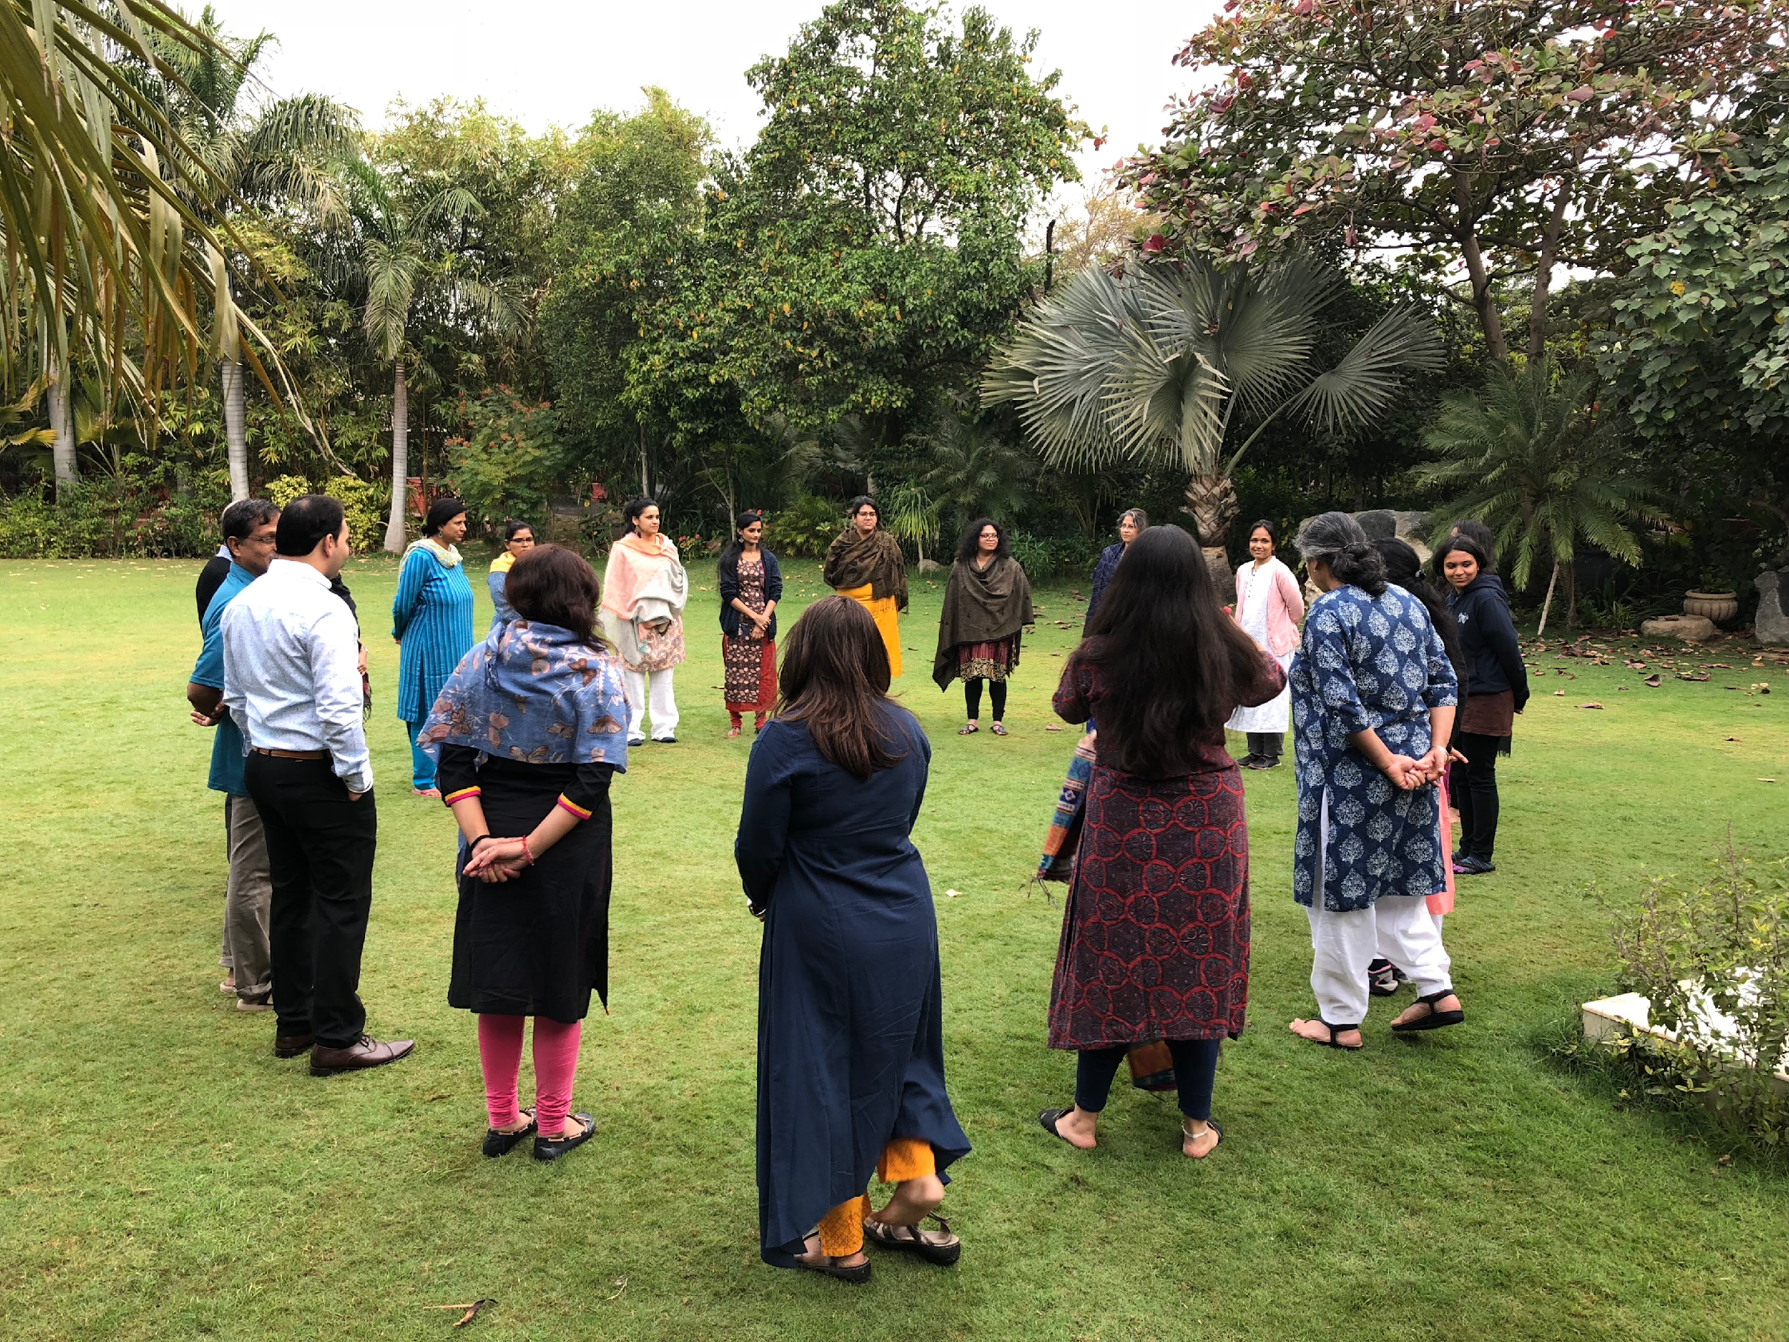
What is a “Circle”?
‘The Circle is a carefully constructed, intentional dialogue space. The process is rooted in a distinct philosophy, which manifests through structural elements that organize the interaction for maximum understanding, empowerment and connection among the participants. The Circle welcomes difficult emotions and difficult realities, while maintaining a sense of positive possibilities.’
Source: Carolyn Boyes – Watson & Kay Pranis, Circle Forward, Building a Restorative School Community,, Living Justice Press, Institute for Restorative Initiatives, 2015

Slide 12
Beyond the opening and closing ceremonies, the Circle itself is a ritual that communicates meaning. Sitting in the round says that everyone is included equally without regard to rank, status, or hierarchy. Shedding titles gives a further message of equality and of looking beyond outer roles to who we are in our hearts. Joining hands expresses community. The opening ceremony invites reflection and a spiritual sense of connectedness. The talking piece cultivates a capacity both to listen and to speak with respect. The guidelines convey shared ownership of the process and responsibility for its outcomes. And the closing ceremony inspires gratitude for the good achieved. Together, these rituals create a secure space where we can share personal stories, express emotions, be honest, take risks, and seek solutions to very difficult issues.
Kay Pranis, Barry Stuart, and Mark Wedge, Peacemaking Circles, 119. These authors from the US, Canada, and First Nations are long-time Circle practitioners and trainers. Circle Forward, 2020

Slide 13
Restorative Practices Continuum
Created by: Bilphena Yahwon

Slide 15
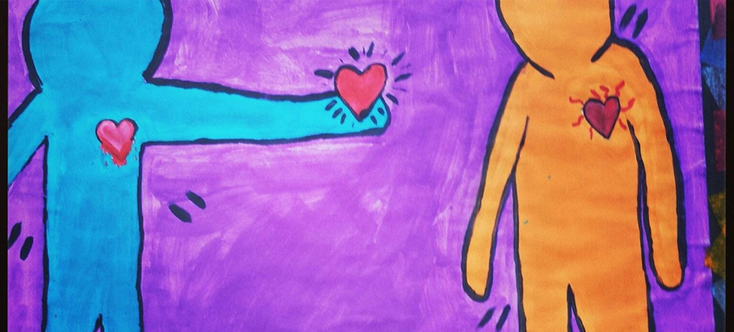
What does the word ‘Restore’ mean?
What does the word mean in the context of life as a human being?
Source: https://www.cacej.org/wp-content/uploads/2014/02/restorative-justice.png

Slide 16
‘What is Restorative Practices’? What are Restorative Approaches?
https://www.youtube.com/watch?v=_obyZY4XzaI (IIRP video 1.51 minutes)
https://www.youtube.com/watch?v=gJJxbn1VjYo (Resolve Consultants – 2.19 minutes)

Slide 17
A lot of what we know about restorative justice arose in the mid-1970s in the US and Canada, out of disaffection for the criminal justice system and its inadequacy in ensuring justice.
For these communities, the principles of balance and harmony were of utmost importance and the first priority of justice was strengthening the community.
However, its roots can be found in various indigenous cultures and faith traditions dating back centuries.

Slide 18
Perspective on ‘offenders’ in the Navajo Peacemaking Process
“When members of the Navajo Nation try to explain why people harm others, they say that a person who does harm to another ‘acts as if he [sic] has no relatives’ (Yazzie 1998: 126; see Kaplan and Johnson 1964: 216–17). That is, the offending person has become so disconnected from the world around him, so disengaged from the people he lives and works with each day, that his acts no longer have a personal foundation.”
Dennis Sullivan & Larry Tifft, “Introduction: The healing dimension of restorative justice: a one-world body”, pp.1-16 at 1 in Sullivan & Tifft, ed., Handbook of Restorative Justice - A Global Perspective (2006).

Slide 19
While conventional justice systems view crime as a violation of the interests of the state, and professionals representing the state decide what should be done about it...
...restorative justice gives primacy to the interests of those most affected - victims, offenders and their community – and empowers them...

Slide 20
How are people referred to in an RJ process?
“In restorative justice, we avoid defining people by their behaviors and experiences with labels like “victim,” “offender,” and “perpetrator” because those terms deny that all people are capable of growth and change. Instead, we use the word “survivor” because it honors that a person is in the process of transcending something painful or unjust. We also use phrases like “the responsible person” or “the person who assaulted the survivor” to show that people are more than the worst thing they have ever done.”
sujatha baliga, “A different path for confronting sexual assault”, Vox, 10 Oct 2018, https://www.vox.com/first-person/2018/10/10/17953016/what-is-restorative-justice-definition-questions-circle

Slide 21
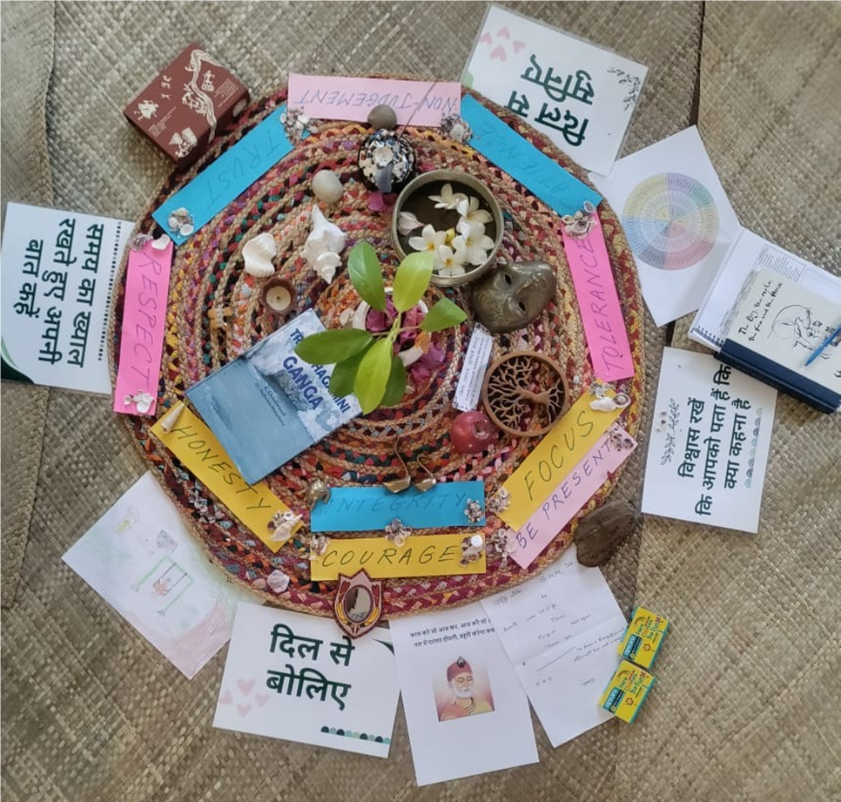
Restorative Justice/’Harm Circles’ -Centre created for prep work at Enfold Proactive Health Trust
with a Person who caused Harm (incest) -a person who claims to be a Sanatini

Slide 22
Self-Reflection
What is your first language? Challenge or Connection?
PAIR SHARE
5
Challenge
(Control)
5
Connection

Slide 23
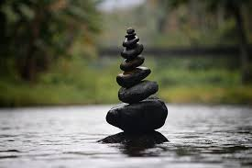
Reflection Exercise:
Think of a recent situation in your leadership where a difficult decision had to be made, or where there was resistance or conflict.
In that moment, where do you think your leadership style fell. Use this scale or mark your response on a blank quadrant:
Did I impose decisions on others?
Did I try to solve everything for them?
Did I avoid confrontation or action?
Did I engage them exercising agency while working with them to promote accountability?

Slide 24
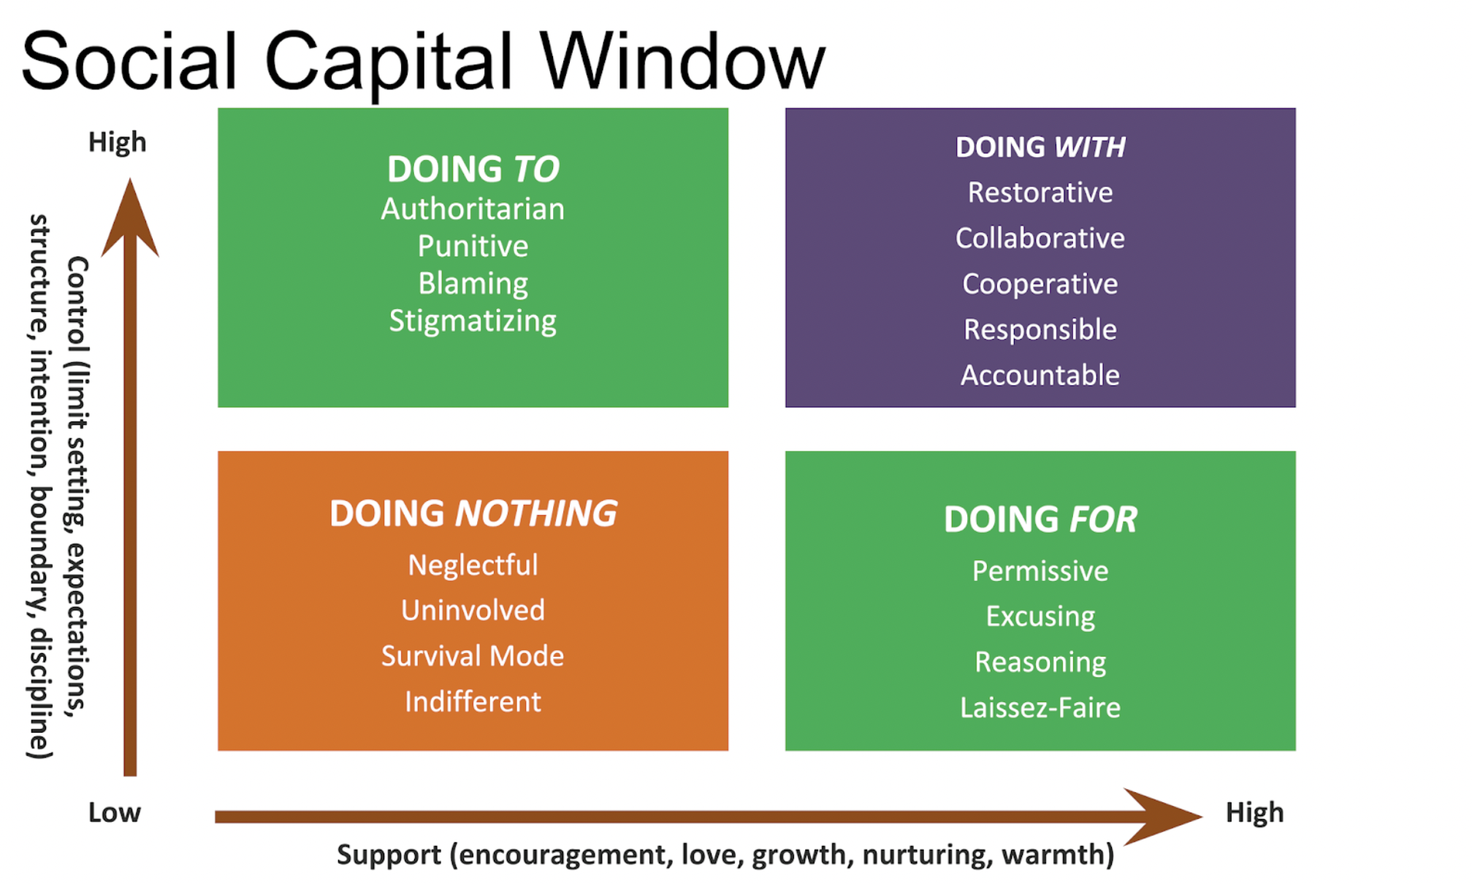
The Social Capital Window categorizes social norms and behavioral expectations into four types of environment, based on degrees of support and control and reflecting the impact of different types of leadership.
Source: Jem Muldoon, The Social Capital Window of Restorative Practices https://jemmuldoon.blogspot.com/2018/10/the-social-capital-window-of.html

Slide 25
Reflection What is my default Leadership style? How can I be more Restorative?
What made me lead from that quadrant?
How did my actions affect the people I was working with?
What would leadership ‘WITH’ look like in this situation?
What support do I need to lead restoratively more often?
Group Discussion:
“As Risen Women in governance, what institutional/organizational culture, supports and systems do we need to create, strengthen and sustain to enable us to lead WITH people instead of over or for them?”

Slide 26
TWO PARADIGMS
Punitive Model
“Power – Based”
Restorative Model
“Collective – Based”
Infraction/Crime
Infraction/Crime
Causes
HARM
Creates
NEEDS
Requires
Repair and Restoration
Causes
HARM
REQUIRES
Severity of Sanction
Source: Pages 28-29, The Restorative Journey – Book One: The Theory & Application of Restorative Practices, Mailk Muhammad, Akoben
www.AkobenLLC.org

Slide 27
“Restorative environments can reclaim antisocial individuals because they satisfy our innate need to establish self-worth and exert influence over our environment. Restorative cultures apply communal pressure to change behavior by utilizing relationships and social connection in lieu of force and coercion. Punishment is transformed into “social consequences” — the need to confront the impact that one’s behavior has on others. Those who harm others or violate norms perceive the consequences of their behavior as the result of that behavior instead of something done to them by an emotionally disconnected authority figure (Brendtro & Larson, 2006, p. 111).”
John Bailie, "Power, Authority and Restorative Practices", IIRP, https://www.iirp.edu/news/power-authority-and-restorative-practices

Slide 28
Definitions
Restorative Process: “any process in which the victim and the offender, and, where appropriate, any other individuals or community members affected by a crime, participate together actively in the resolution of matters arising from the crime, generally with the help of a facilitator. Restorative processes may include mediation, conciliation, conferencing and sentencing circles.”
ECOSOC Basic Principles on the Use of Restorative Justice Programmes in Criminal Matters, 1999
“Restorative justice” refers to any process which enables those harmed by crime, and those responsible for that harm, if they freely consent, to participate actively in the resolution of matters arising from the offence, through the help of a trained and impartial third party (hereinafter the “facilitator”).
Council of Europe’s Recommendation of the Committee of Ministers to Member States concerning Restorative Justice in Criminal Matters, 2018

Slide 29
Two Different Approaches to Justice
Source: Howard Zehr & Ali Gohar, The Little Book on Restorative Justice (2003) pp. 19-20
Criminal Justice
Restorative Justice
Crime is a violation of the law and the state
Violations create guilt.
Justice requires the state to determine blame (guilt) and impose pain (punishment).
Central focus: offenders getting what they deserve.
Crime is a violation of people and obligations
Violations create obligations
Justice involves victims, offenders and community members in an effort to put things right.
Central focus: victim needs and offender responsibility for repairing harm

Slide 30
Different Questions
Source: Howard Zehr & Ali Gohar, The Little Book on Restorative Justice (2003) pp. 19-20
Criminal Justice
Restorative Justice
What laws have been broken?
Who did it?
What do they deserve?/How should they be punished
What happened?
Who has been hurt?
What are their needs?
Whose obligations are these?
What can be done to repair the harm and make things right?

Slide 31
Justice as Repairing Harm & Healing: Howard Zehr
Crime is a violation of people and relationships
↓
Those violations create obligations
↓
The central obligation is to do right by those you’ve harmed

Slide 32
At its core, Restorative Justice is about relationships—how you create them, maintain them, mend them. It’s based on the philosophy that we are all interconnected, that we live in relationship with one another, & that our actions impact each other.
Grounded in the idea of interconnectedness, restorative justice is able to provide an alternative way of addressing wrongdoing or harm. Harm is seen as damaged relationship. We are in direct relationship with the people we harm—sometimes we know the person we harmed, sometimes we don’t and the relationship begins at the moment of harm.
In recognizing that, Howard Zehr really calls us to a paradigm shift in how we look at and frame justice as a concern for healing or repairing harm directly to the person harmed as much as possible.

Slide 33
Common Attributes of RJ Processes
Victims provided an opportunity to
Offenders provided an opportunity to
Be directly involved in resolving the situation and addressing the consequences of the harm/offence
Acknowledge responsibility for harm/offence and understand the effects of the offence on the victim
Receive answers to their questions
about the harm/crime and the offender
Express emotions (even remorse) about the harm/offence
Receive support to repair harm caused to victim, victim’s family, community or even oneself & one’s family
Express themselves about the impact of the offence
Receive restitution or reparation
Make amends or restitution/reparation
Receive an apology
Apologize to victim/s
Restore, when appropriate, a relationship with the offender
Restore their relationship with the victim, when appropriate
Source: UNODC, Handbook on Restorative Justice Programs (2006) p. 17

Slide 34
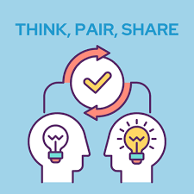
Pair Share Activity
Think of a time when you were harmed by someone else (a mild harm, perhaps 3 or 4 on a scale of 10, not something that triggers you).
Think of a time when you caused harm to someone else.

Slide 35
United Nations Basic Principles on the Use of Restorative Justice Programmes in Criminal Matters, 1999
Free and voluntary consent of the victim and offender is necessary.
Agreements - voluntary, reasonable & proportionate obligations.
Agreement on basic facts of a case should be the basis for participation.
Participation of the offender should not be used as evidence of admission of guilt in subsequent legal proceedings.
Power imbalances, cultural differences among the parties, and safety of the parties should be considered while referring a case and in conducting a restorative process.

Slide 36
Basic principles of Restorative Justice
13. The core principles of restorative justice are that the parties should be enabled to participate actively in the resolution of crime (the principle of stakeholder participation), & that these responses should be primarily oriented towards addressing & repairing the harm which crime causes to individuals, relationships & wider society (the principle of repairing harm).
14. Other key RJ principles include: voluntariness; deliberative, respectful dialogue; equal concern for the needs & interests of those involved; procedural fairness; collective, consensus-based agreement; a focus on reparation, reintegration & achieving mutual understanding; & avoiding domination.
15. RJ should not be designed or delivered to promote the interests of either the victim or offender ahead of the other. Rather, it provides a neutral space where all parties are encouraged & supported to express their needs & to have these satisfied as far as possible.
Source: Recommendation CM/Rec(2018)8 of the Committee of Ministers to member States concerning restorative justice in criminal matters

Slide 37
Restorative Agreements
50. Agreements should only contain fair, achievable and proportionate actions to which all parties provide free and informed consent.
51. Agreements do not have to include tangible outcomes. The parties are free to agree that the dialogue sufficiently satisfied their needs and interests.
Source: Recommendation CM/Rec(2018)8 of the Committee of Ministers to member States concerning restorative justice in criminal matters

Slide 38
Preparation for a Circle
Suitability of the Circle process
Preparing the parties for the Circle
Planning the specifics of the Circle
Self- preparation
Source: Kay Pranis, Circle Keeper’s Handbook (2014)

Slide 39
1. Suitability of Circle Process
Are there people who are willing to participate?
Is the person who caused harm willing to be accountable for their actions?
Has each person made an informed choice to participate?
Are family members or support persons available for person harmed and person who caused harm?
Is there a risk of emotional and physical harm and if yes, can it be managed?
Is the person harmed or person who caused harm dependent on substances or alcohol?
Is the person who was harmed above x years?
Is the person who caused harm below/above x years?
Any other factors that may impede informed participation (addiction, mental health)
Is the intent respectful of all possible participants?
Am I (facilitator) hoping to convince others of a particular point of view/change others?

Slide 40
2. Preparation with Person Harmed
Build relationship (values)
Who are your people?
Impact Statement
Explain facilitator’s role
Describe purpose of Circle
Listen to their account and create space for venting
Explain the potential benefits
Describe the Circle process
Identify Supporters & Community
Address questions, barriers, and concerns
Source: Impact Justice, Harm Circles Participant Guide (2019)

Slide 41
Impact Statement (prep)
What happened?
How is this incident affecting you?
How is it affecting your family?
What concerns do you have today, if any?
What would you like the person who caused harm to know?
What would you like to happen now to make things right for you and your family?
Is there any other information you would like to share regarding this incident and its impact on you and your family?
Source: Impact Justice, Harm Circles Participant Guide (2019)

Slide 42
2. Preparation with Person who caused Harm
Build relationship (values, strengths-based approach)
Who are your people?
Letter of Apology
Explain facilitator’s role
Describe purpose of Circle
How would they like to repair the harm of all impacted, including themselves
Explain the potential benefits
Describe the Circle process
Identify Supporters & Community
Address questions and concerns
Source: Impact Justice, Harm Circles Participant Guide (2019)

Slide 43
Questions in a RJ Harm Circle
What happened?
What has been the impact on you?
Who else has been impacted?
What was hard about this for you?
What were you thinking then and what are you thinking now?
What is unspoken in the Circle?
What is needed to be able to move forward in a good way? OR What needs to be done to make things as right as possible?
What change would you like to see and what can be done to support that change?

Slide 44
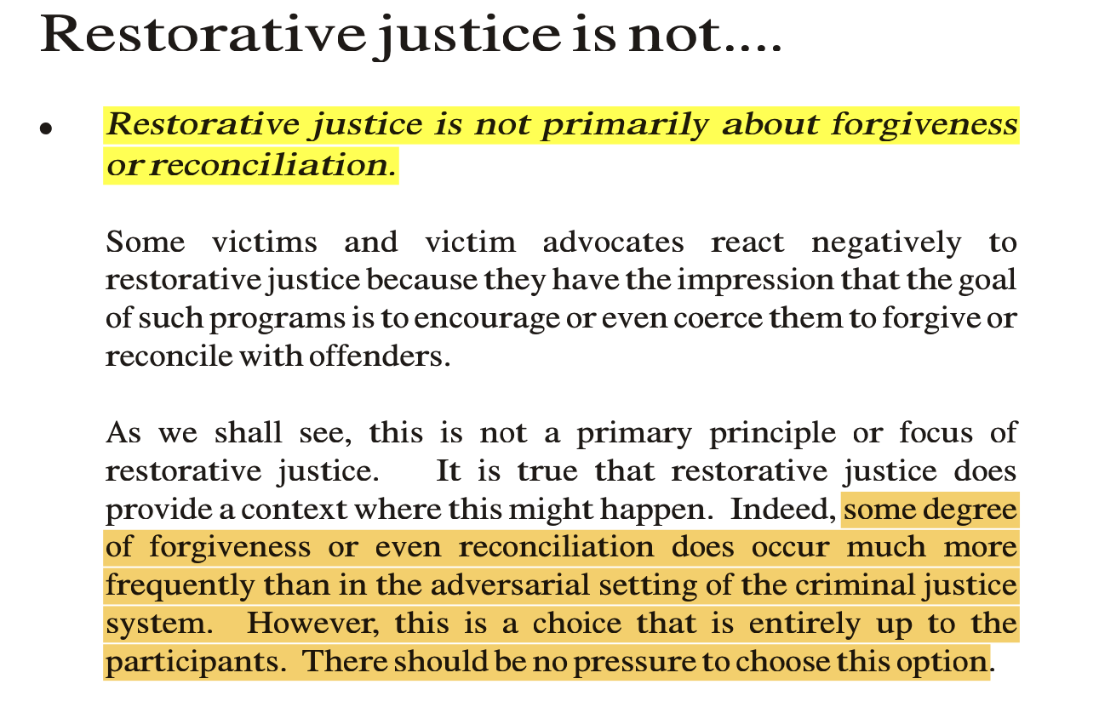
Zehr & Gohar, Little Book of Restorative Justice, p.8

Slide 45
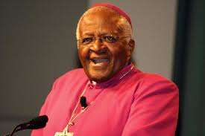
Archbishop Desmond Tutu No Future without Forgiveness (2000)
"In forgiving, people are not being asked to forget. On the contrary, it is important to remember, so that we should not let such atrocities happen again. Forgiveness does not mean condoning what has been done. It means taking what happened seriously and not minimizing it; drawing out the sting in the memory that threatens to poison our entire existence. It involves trying to understand the perpetrators and so have empathy, to try to stand in their shoes and appreciate the sort of pressures and influences that might have conditioned them.”

Slide 46
What does forgiveness look like?
“This study and previous psychological work clearly sees reduction of revenge feelings, closure and greater feelings of safety as strongly associated with, or even making up forgiveness. If we were to take this position, then restorative justice, because it can encourage these aspects, also produces forgiveness. Yet, victims in our evaluation only very rarely used the word ‘forgive’ and sometimes specifically rebutted ‘forgive’ though they would accept ‘closure’, ‘moving on’, and ‘helped me’.”
Joanna Shapland, “Forgiveness and Restorative Justice: Is it Necessary? Is it Helpful?”, Oxford Journal of Law and Religion, Volume 5, Issue 1, February 2016, Pages 94–112, https://academic.oup.com/ojlr/article/5/1/94/1752338

Slide 47
Mediation & Restorative Circles
”The main difference between circles, mediation and conferencing lie in the following features of circles:
Ceremonies and rituals as a framework;
The circle format that creates a special dynamic in the dialogue;
The inclusion of the wider community and of the judicial representatives (if possible);
The potential of circle participants to create the values and rules of the discussion;
The keeper’s role that is different from a mediator’s or a conference facilitator’s roles; and
The consensus-based decision making that covers all participants.”
Handbook for Facilitating Peacemaking Circles

Slide 48
What does the evidence on RJ in sexual offence cases tell us?
“Daly’s (2006) comparison of cases proven in court and conference cases revealed:
Victims were more likely to receive a verbal and written apology than at court (77 compared to zero, 32 compared to 1, respectively),
Likelihood of achieving an agreement from the young offender to stay away from them higher in conference cases(documented in 23 compared to 10 cases).
Offenders were more likely to attend counselling (79 versus 49 counts) and specifically specialist sex offender counselling (52 versus 37 counts).
Conference cases were finalised more quickly from report to finalisation (a median of 2.5 months in conference compared to 5.7 months at court).
Much higher admission of sexual abuse that occurred as part of the family conference (94%) compared to court where only 51% were finalised with a sexual component proven.”
Report for the Royal Commission into Institutional Responses to Child Sexual Abuse, 2016, p.32.

Slide 49
Evidence of Effectiveness of RJ
Substantial reduction in repeat offending
Reduction in victims’ post-traumatic stress symptoms and related costs;
Provided both victims and offenders with more satisfaction with justice than the criminal justice system;
Reduced crime victims’ desire for violent revenge against their offenders;
Reduced the costs of criminal justice, when used as diversion from criminal justice system;
Reduced recidivism more than prison (adults) or as well as prison (youths).
Source: Sherman & Strang, Restorative Justice: The Evidence, The Smith Institute (2007). Based on review of research on 36 comparisons of RJ with criminal justice system in UK and abroad.

Slide 50
Application in Serious Offences
“…given the practicality of limited resources, restorative justice processes should be aimed at the more serious offences. It is here that the impact of the offending on victims is greatest and that victims are most in need of closure...”
…“Restorative justice processes are most appropriate for repeat offenders.”
Allison Morris & Gabrielle Maxwell, “Implementing Restorative Justice: What Works?” in Morris & Maxwell, Ed., Restorative Justice for Juveniles Conferencing, Mediation and Circles, 2001, p.270.

Slide 51
“No crime victim should be forced to confront her perpetrator, but neither should she be denied the opportunity if she desires it.”
Mary P Moss

