Slide 1
Land-grabbing in West Papua
Paul Rahmat SVD
VIVAT International
Presented at JCoR’s Global Community Hour
January 10th, 2025

Slide 2
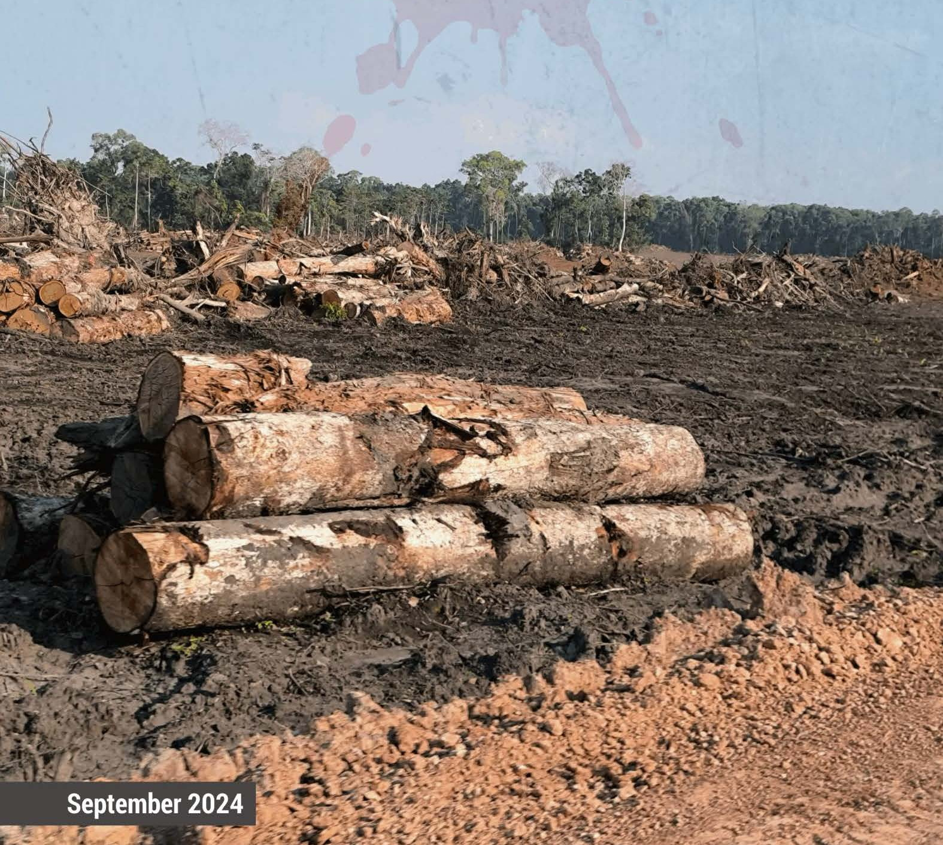
Agenda
An Introduction: setting the context
The Integrated Food Estate project in Merauke
The impacts of the Project
The Indigenous People’s Resistance in West Papua
The Ambiguity of the Catholic Church’s role in WP

Slide 3
Where is West Papua?
WP is situated in Eastern Indonesia, in Asia-Pacific.
Located between Asia and Australia; between Pacific Ocean and Indian Ocean
At the border of Papua New Guinea
It has been part of and under the occupation of the Republic of Indonesia since 1963.
West Papua is home to over 250 distinct Indigenous tribes, each with its own language and cultural practices; most of these tribes are considered Melanesian.

Slide 4
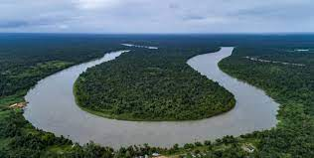
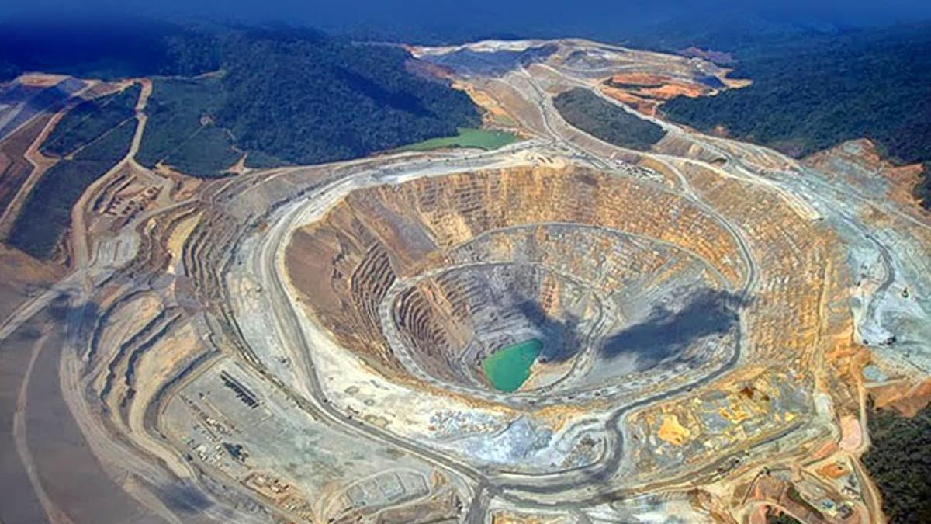
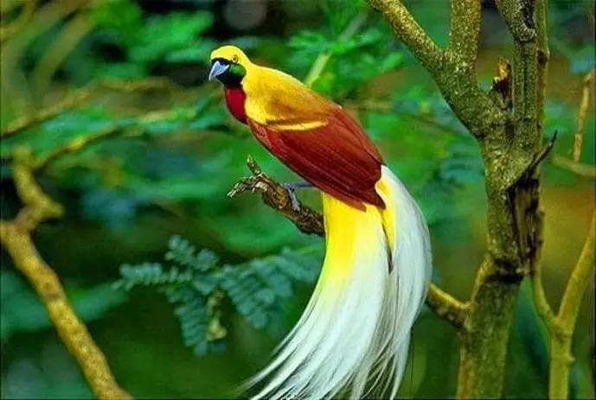
A World Lungs with Plenty of Natural Resources
WP is one of the World’s lungs with plenty of natural resources
Forest, timber, biodiversity - flora and fauna
Home of the world’s gold, silver and copper

Slide 5
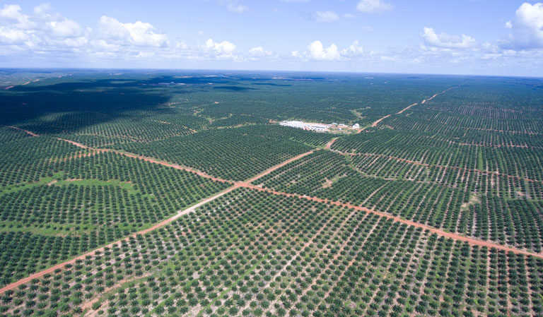
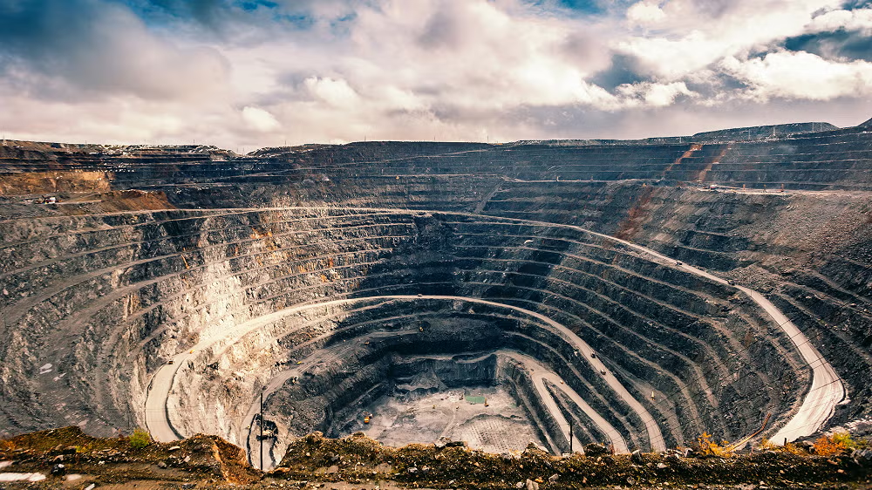
The World’s Lungs at Risk of Exploitation by Extractive Companies
Gold and copper mining
Timber, palm oil and sugarcane plantation
National Strategic mega-projects for food and energy security development
A huge Palm Oil Plantation in WP
Gold Mining in WP

Slide 6
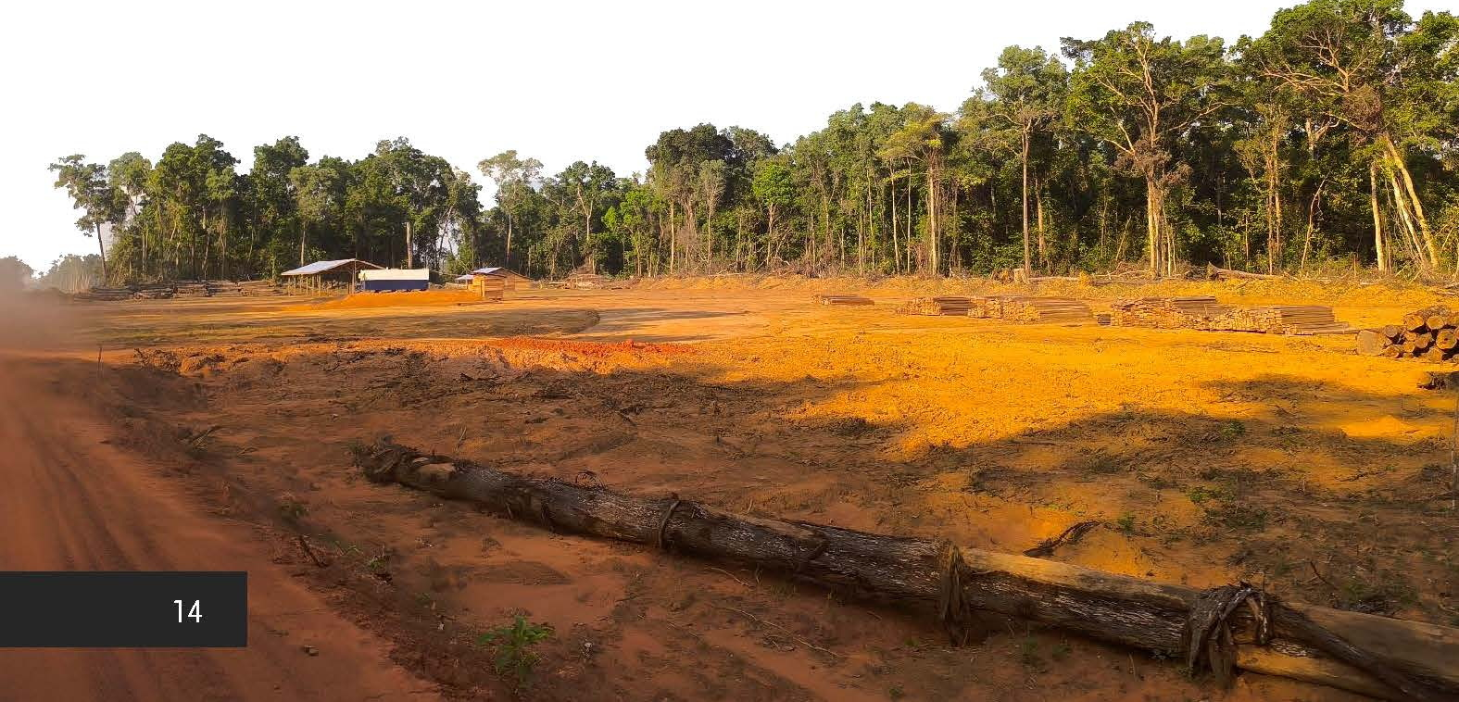
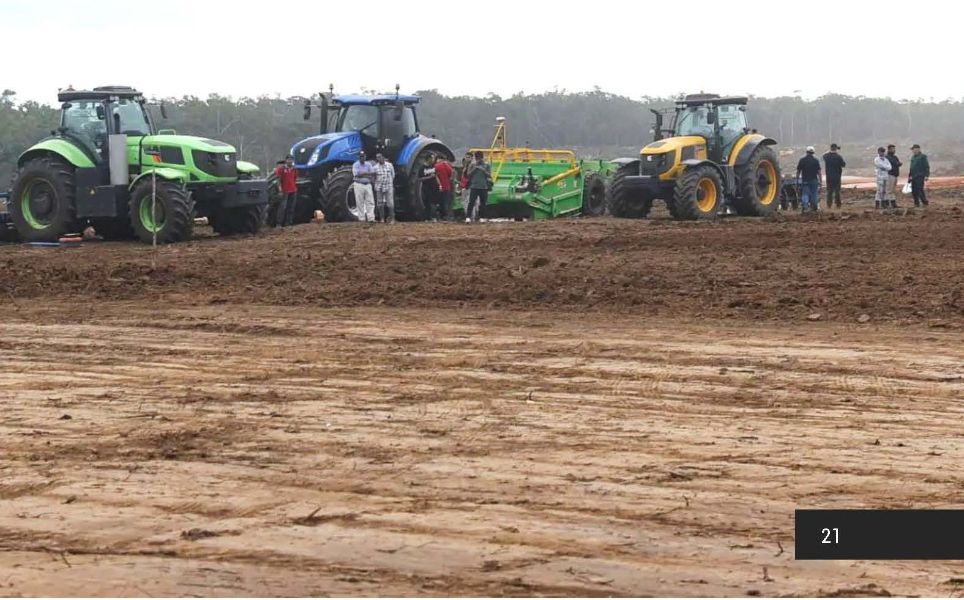
Land Grabbing and Integrated Food Estate Project in WP
Context: Food and energy crisis nationally and globally due to i.e. environmental degradation, climate change, and conflicts.
In response to the crisis, the Indonesian government introduced an “integrated Food Estate project” called Merauke Integrated Food and Energy Estate (MIFEE)
Aims at producing rice & sugarcane in a total area of 2 million hectares in Merauke, South Papua Province.
The entire MIFEE project is located within the indigenous territory of the Marind and Yei people and Forest Areas.

Slide 7
Private Sectors Intervention
38 national and transnational corporations involved in the MIFEE project in a total area of 1,580,000 ha.
The government is making agreements to grant permits for land use without consulting, meaningful participation, or free consent of the Indigenous peoples (the FPIC principle).
The project benefits a few people and/or business entities (2 wealthy families only); while The Indigenous peoples lost control over and rights to land, forests, and natural resources
Type of Business | Companies | Total land-use area (in hectare)
Sugarcane Plantation | 18 | 548,194
Crops cultivation | 3 | 82,483
Palm Oil plantation | 10 | 297,418
Industrial forest business | 7 | 660,556

Slide 8
Impacts of Land Grabbing in WP
Militarization
Internally Displaced People
Deforestation
Increase emissions
Biodiversity loss
Ignore FPIC Principle
Human rights abuse
Threats to defenders, Journalist, film makers
Internal Migration
Impacts of Land Grabbing in West Papua
Deforestation & increase emissions
Biodiversity loss
Threats to local food & livelihood of Indigenous people
IDPs & eviction of Indigenous communities
Internal migrants occupying Indigenous people’s lands
Violate Human rights
Threats to HR & environmental defenders, journalists & Filmmakers
Militarization
FPIC principle ignored

Slide 9
Local Communities and Indigenous People Resistance
The Indigenous communities in West Papua together with Churches and NGOs have resisted the food-integrated projects in Merauke.
“Therefore, we ask… the President of the Republic of Indonesia and ministries and State Institutions related to National Strategic Projects Merauke to stop this project.”
A statement made by Indigenous community representatives of Malind, Maklew, Yei, and Khaimaima

Slide 10
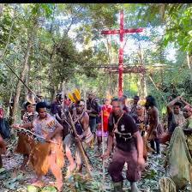
Red-Cross An Icon of Indigenous People’s Resistance
The West Papuans have planted "RED CROSS" everywhere - at sacred and historical sites, public places, and churches’ premises.
RED CROSS symbolizes a resistance movement of Indigenous communities against the hegemonic power of the state, militarism, and corporations.
The sticking of the Red Cross is followed by the observance of the Stations of the Cross and the Divine Mercy Prayer throughout West Papua.
These religious practices signify the social and political resistance of the indigenous people to the MIFEE projects and land grabbing.

Slide 11
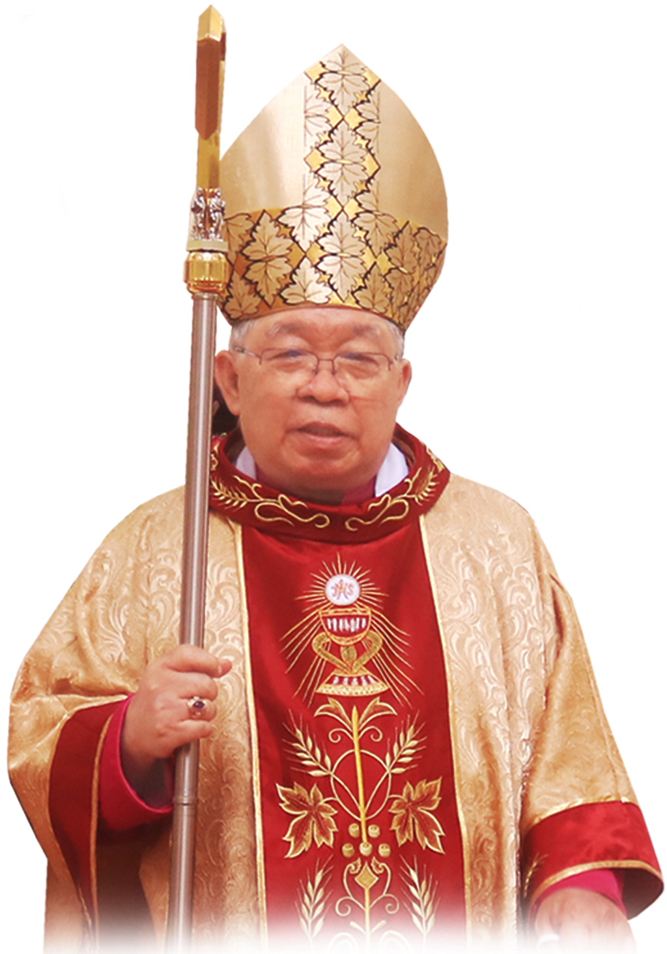
The Ambiguity of the Catholic Church’s Role
The role and position of the Catholic Church authorities in West Papua is ambiguous.
Majority of Roman Catholic Priests of Indigenous Papuans rejected the project and they are on the side of Indigenous communities to do resistance
The Archbishop of Merauke and some priests endorse the project.
They go hand in hand with the central Government, military officials, and corporations and get some benefits (facilities) from the relationship with the high ranks of the authorities.
Mgr. Petrus Canisius Mandagi, MSC. Archbishop of Merauke

Slide 12
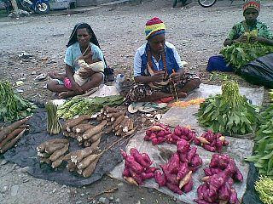
To Conclude …
Indigenous West Papuans are facing an existential threat;
They are in a conflict situation from “slow-motion genocide” to “ecocide”;
The indigenous Papuans are struggling to survive in their ancestral territory.
Papuans Mama-mama (mothers) sell their crops at the traditional market

