Slide 1
Issue Introduction: Global Homelessness
JCoR Global Community Hour
Prayer and Reflection | May 10, 2024
Jean Quinn, DW
Executive Director, UNANIMA International
Liana Almony
Deputy Director, UNANIMA International

Slide 2
Mission and Vision
Mission: UNANIMA International is a Nongovernmental Organization (NGO) advocating on behalf of Women and Children (particularly those living in poverty), Migrants and Refugees, the Homeless and Displaced, and the Environment. Our work takes place primarily at the United Nations Headquarters in New York, where we and other members of Civil Society aim to educate and influence policy makers at the global level. In solidarity, we work for systemic change to achieve a more just world.
Vision: A future where Women and Children who live in extreme poverty in our society will be empowered to achieve a better quality of life.

Slide 3
Opening Reflection
Scripture 1 John 1:5-7
Wisdom is Light. Now this is the message that we have heard and proclaim now; Wisdom is Light and in her there is no darkness at all …… if we walk in the Light as Wisdom is in the light, then we have community with one another.

Slide 4
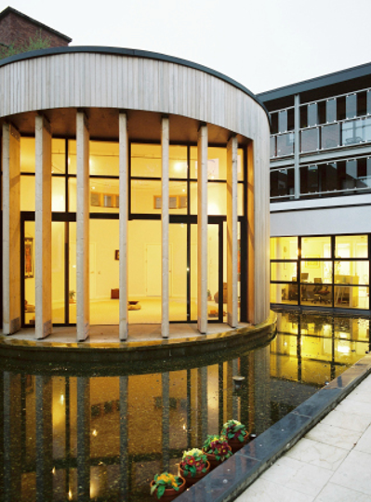
The Samaritan Woman
Jennifer’s Story: A Woman’s Lived Experience of Homelessness
Allow me to introduce you to my friend Jennifer. A battered woman, a survivor, a daughter, a sister, a mother. A woman broken by her experience of domestic violence. A woman locked in years of pain and agony. A woman who was brutally raped and abused, and the woman who attempted suicide.
Who wanted to listen to Jennifer’s story? Why would Jennifer, who never trusted anyone, want to trust me? I was blessed with time, patience, caring, and with a very deep respect for all people. I had the time to spend with her. I met her sitting on the street outside a cinema in Dublin with her bags and all her worldly possessions at her feet. I sat down beside her on the street on a beautiful summer morning. She sat there silently, refusing to look at or respond to me. I sat with her and tried to listen to her silence. The street was filled with her pain. She began to look at me. I reached out and touched her. I assured her I could take her to a safe place (wondering as I saw all the black bags how I would get her to a safe place while making sure she could take all her belongings with her).
We began our journey to a safe house—me with the bags and Jennifer under my arm. We eventually arrived at the safe house. Many hours later as I sat with her, her only words were “how much more do I have to take.” She slowly started to tell me about her violent relationship with her partner. How the drinking and the cutting of her body brought her relief from the abuse she was experiencing. All she knew about herself was that she was a nameless woman, an unwanted woman, and a woman with no dignity or respect.
Hitting rock bottom became a blessing and a possibility for her, a threshold of hope, and a new beginning. I journeyed with her for several years and eventually a deep friendship evolved. I realized during this time what the God of our lives is all about, God active in each other. She introduced me to the margins and to the thin places in our world. She loved to celebrate, and she would invite her friend, and prepare the table (which was initially an orange box), where we would share a meal, and share our stories. A ritual of healing, and of how our wounds ached for recognition. These moments were wonderful moments for me, moments of laughter and blessing. We were each coming back to a place called home within ourselves. She would often say to me “isn’t it wonderful to be loved again.”

Slide 5
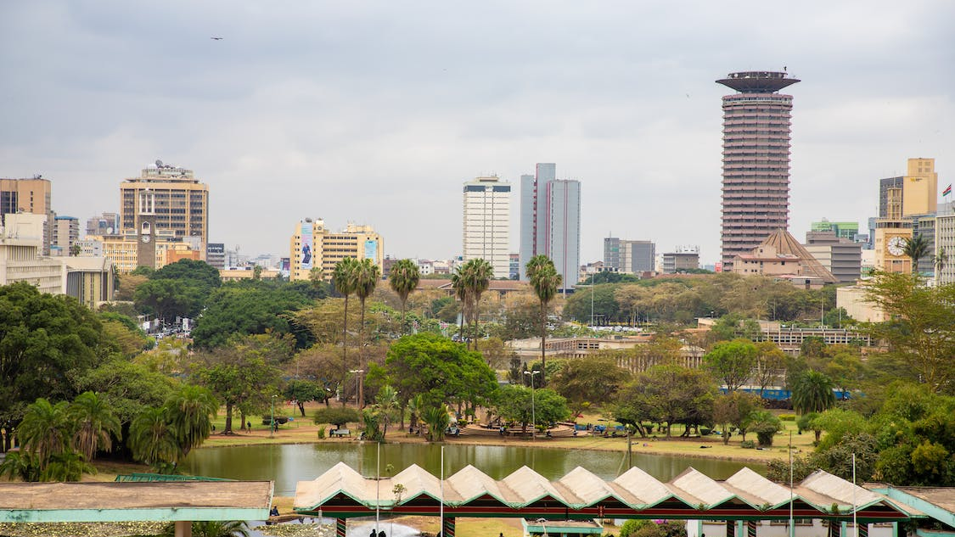
“Homelessness is a condition where a person or household lacks habitable space with security of tenure, rights and ability to enjoy social relations, including safety. Homelessness is a manifestation of extreme poverty and a failure of multiple systems and human rights.”
- Expert Group Meeting,
Proposed Definition

Slide 6
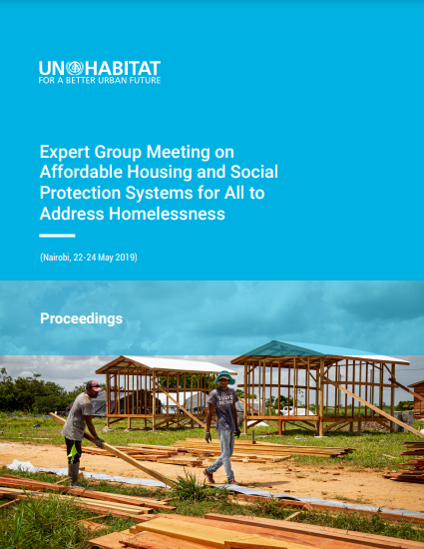
Drivers of Homelessness
Addressing the structural causes of homelessness is critical. Drivers identified at the Expert Group Meeting in Nairobi were:
Poverty
Inequality
Unemployment
Vulnerable jobs
Ill health
Disability
Discrimination and social exclusion
Lack of Affordable housing
Commoditization of housing
Forced eviction
Urbanization
Rural-urban migration
Displacement due to natural disasters
Extreme weather
Conflict

Slide 7
Urbanization & Homelessness
It is estimated that no less than 150 million people are homeless. Approximately 2% of the world’s population are living on the streets, in temporary dwellings, refugee camps, or in transitory conditions.
UN-Habitat estimates that about 1.6 billion people – more than 20% of the world’s population – live in inadequate housing (100 million+ have no housing at all).
For women and children, homelessness is often invisible. The dangers they face on the streets motivate families to exhaust all other options available within their cultural context.
Urbanization is increasing, often rapidly, causing detrimental effects for people, the planet, and infrastructure.
Family breakdown is both a cause and effect of family homelessness. As an effect, families are split up in shelters, and poor children are subject to state and other interventions.
People migrating from rural to urban areas in developing countries often move directly into slums and/or housing that is inadequate because they lack alternative opportunities.

Slide 9
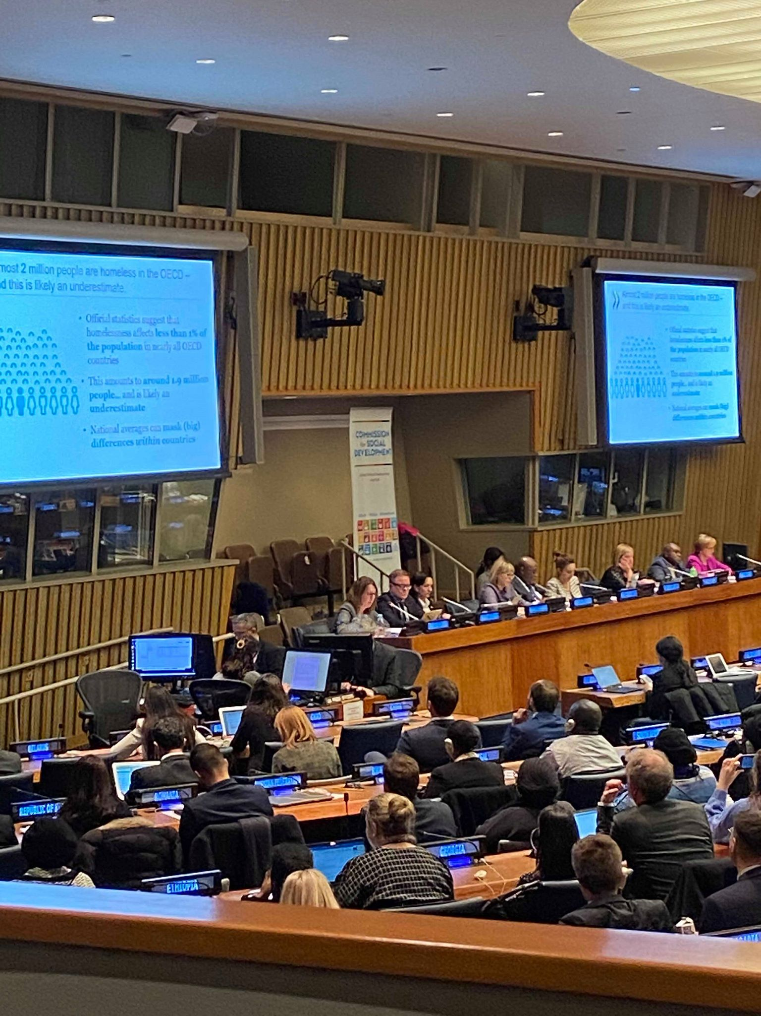
The UN and Homelessness
Background:
In 2017/2018 group of NGOs came together to address the issue of homelessness and bring it to the attention of the UN. The Working Group to End Homelessness (WGEH) was formed.
The working group put together a significant advocacy campaign making effort to push the issue of homelessness at every opportunity.
Advocacy by the WGEH and friendly member states at the 57th Commission for Social Development (CSocD57) lead to “Affordable housing and social protection systems for all to address homelessness.” being adopted as the CSocD58 priority theme.
An Expert Group Meeting on the topic of Homelessness was convened in Nairobi, Kenya in May 2019 in preparation for the 58th Commission for Social Development
This led to the historic passing of the first ECOSOC resolution on homelessness, which was formally adopted in June 2020.
In 2021, through the work of the Third Committee of the General Assembly, Member States adopted a second resolution on homelessness, titled “Affordable housing and social protection systems for all to address homelessness, including in the aftermath of the coronavirus disease (COVID-19).”
Following the adoption of this resolution, in 2023 the Secretary-General presented a report to the General Assembly on Inclusive Policies and Programmes to Address Homelessness

Slide 10
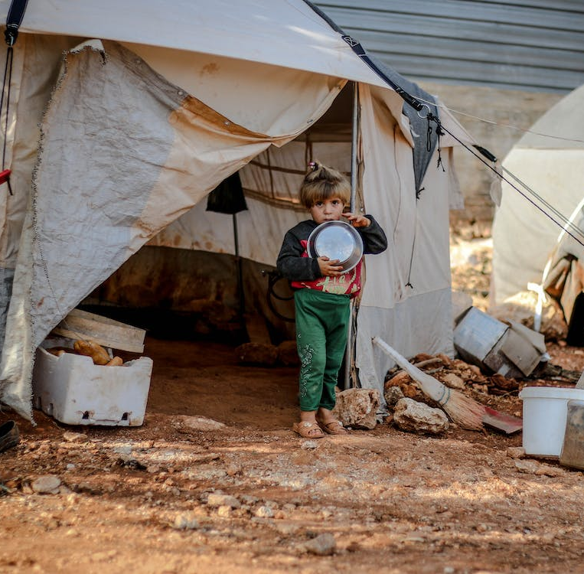
Addressing Homelessness
Address Root and Structural causes
Member States are encouraged to develop concrete strategies (social, cultural, economic) and specific interventions to address all categories of homelessness
To effectively address homelessness
Prevent
Provide support
Address root causes
Personal and family circumstances, such as mental health, domestic violence, relationship breakups, substance misuse all need to be addressed
To empower the participation of people living in the different categories of homelessness all policies should involve and hear the voices of those living in poverty.

Slide 11
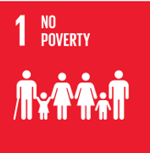
Addressing Homelessness & the SDGs
Addressing homelessness assists Member States in implementing various SDGs. Homelessness wasn’t addressed at the UN as a priority theme until 2020.

Slide 12
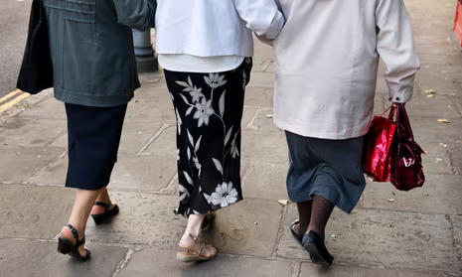
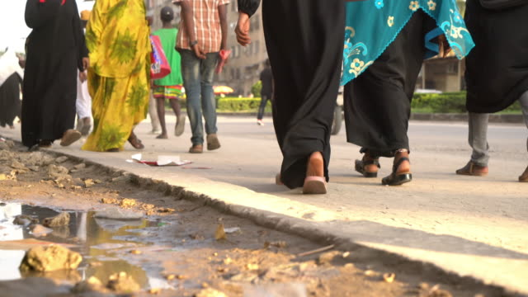
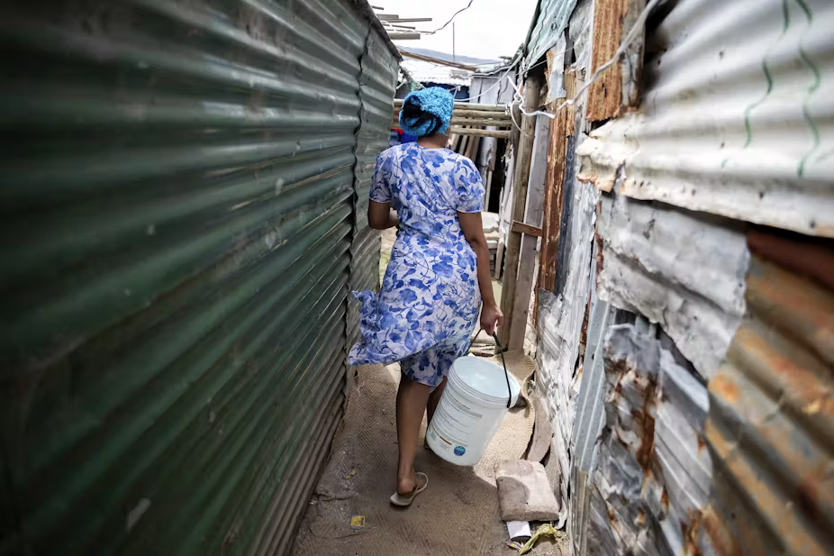
I have personally walked in places where homeless people walk. I have listened to their stories And their stories coax me to be confident. They encouraged me to sing new melodies From the frightening places within. They invite me to sit with them throughout the night Beggar to beggar, Learning to celebrate the touch, Gentle in its respectfulness Seeking not to dominate But to share Here Sophia meets each of us As we unravel the stories of our lives. Sophia helping us to pass the night, Whatever the night is for us, Dreaming us to another place, A place where perhaps, where we will dance again In the arms of a new dawn.
Jean Quinn, DW

Slide 13
Closing Reflection Christ Be Our Light
Longing for light we wait in darkness.
Longing for truth we wait for you.
Make us your own your holy people,
Light for the world to see.
Christ be our light!
Shine in our hearts,
Shine through the darkness.
Christ, be our light!
Shine in our community gathered today.
Longing for peace, our world is troubled.
Longing for hope many despair.
Your word alone has power to save us.
Make us your living voice
Christ be our light - repeat as above
Longing for food, many are hungry.
Longing for water, many still thirst.
Make us your bread, broken for others,
Shared until all are fed.
Christ be our light - repeat
Longing for shelter, many are homeless,
Longing for warmth, many are cold.
Make us your building, sheltering others,
Wall made of living stone.
Christ be our light - repeat

Slide 14
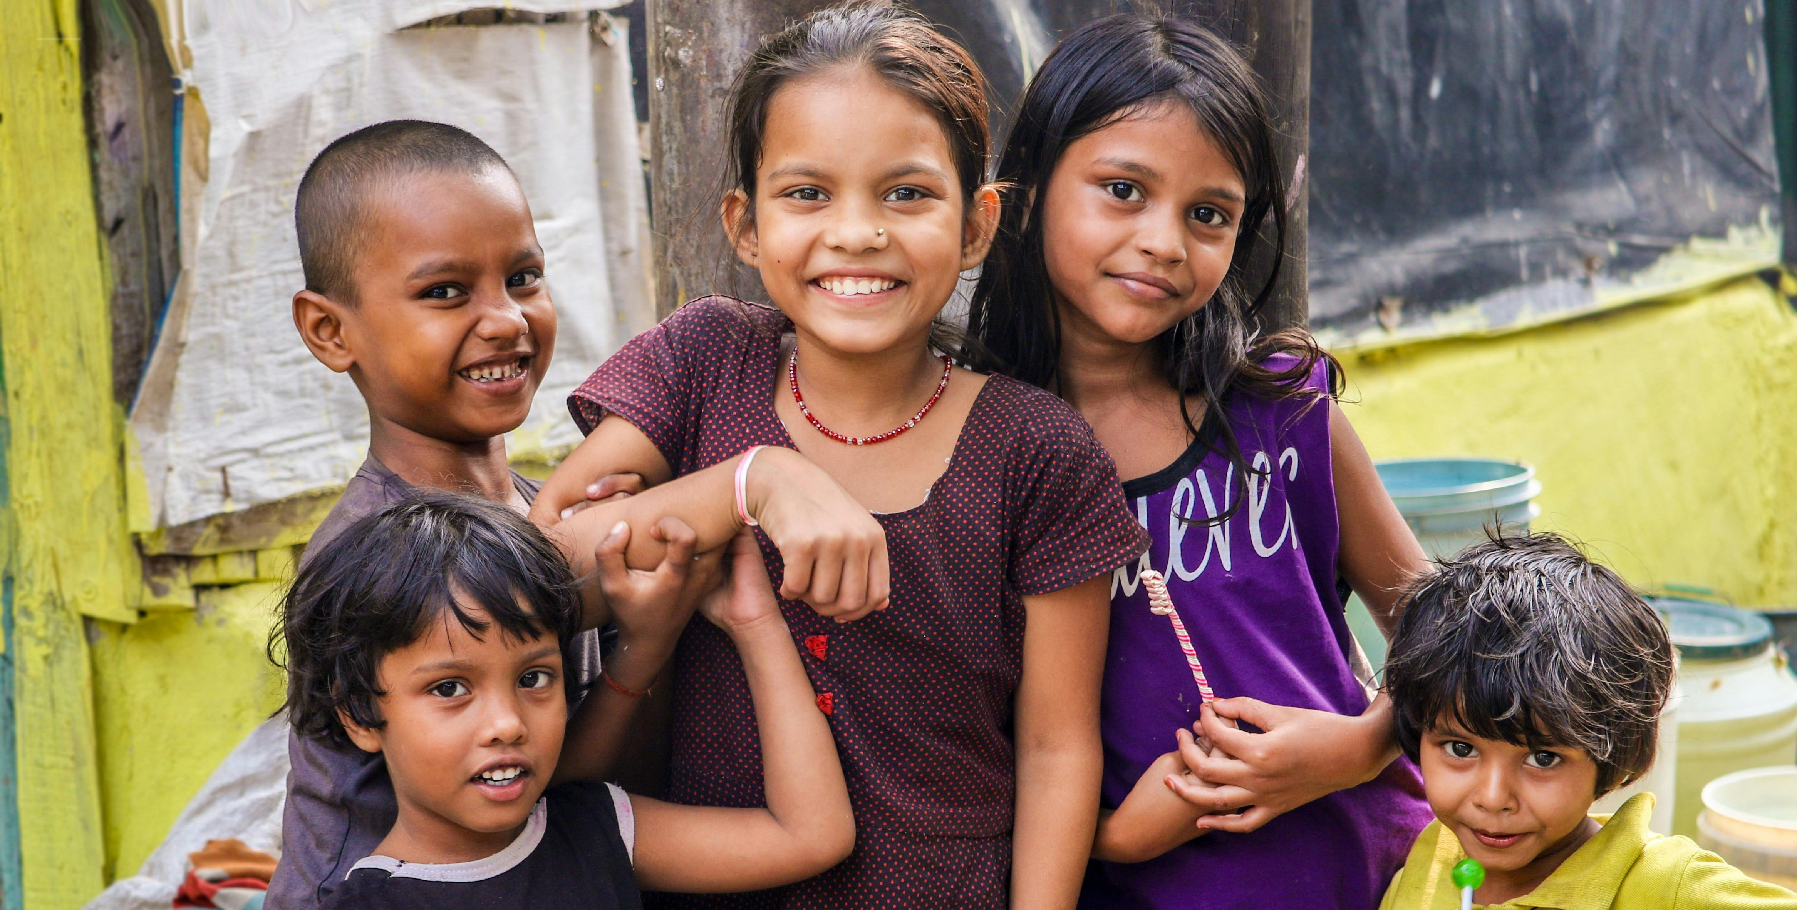
Thank you! www.unanima-international.org
Jean Quinn, DW
director@unanima-international.org
Liana Almony
execasst@unanima-international.org

