Slide 1
Water and sanitation
A Water Project for and
with the People
By: Sr. Elaine Kohls
Medical Mission Sister

Slide 2
Introduction
In April 1969 the Medical Mission Sisters began the hospital in Attat, Gurage Zone, Ethiopia.
As the Sisters drilled for water for the hospital they asked the local people if they needed water but were told that, ”The river water tastes better”.
In 1984 (fifteen years later) I arrived in Attat.
Many villages in and around Attat were in need of water and willing to help with securing it.

Slide 3
How the program started
In 1984 - 1985 a horrendous famine happened and the world learned about a continent called Africa and a country called Ethiopia and help and assistance arrived.
I and Mr. Demeke Haile, the head of Public Health in Attat, were invited to see the area in need of water and were even served the river water!

Slide 4
What All Happend….
Help and assistance arrived:
  Catholic relief service (CRS) drilled 28 boreholes in the villages - almost for free.
  Kale Hiwot (a Protestant group) drilled 25 boreholes and 21 were wet.
  We protected some springs and dug hand dug wells with support from the villagers.

Slide 7
What Was Done….
In1986 our first hand dug well was completed in Koromea village and it is still functioning after 36 years!
The number of water sites as of 2018:
  There are 102 shallow boreholes with hand pumps (84%).
  Now there are only 4 (3%) hand dug wells with hand pumps, 11 (9%) deep boreholes with electric or solar pumps and 5 (4%) protected springs.

Slide 8
Changes with a safe water supply
  Less number of hospital admissions with diarrhea and other preventable diseases.
  Hospital is better able to function as a hospital.
  Public health programs were strengthened in the villages with health education, vaccination programs, development of women’s groups, micro credit scheme, etc.

Slide 9
Changes cont’d…..
  Daughters could now go to school as they did not have to spend time to travel far for water.
  Their mothers also now had more time for other activities.
  Village Development Committees (VDCs) were established in the villages.

Slide 10
Changes cont’d…..
  A Village Development Committee (VDC)
  consists of:
    5 or more members (elders, at least one woman, a secretary and a treasurer)
    Provides leadership for the village, manages the finances, sees to the payment of the pump attendant, contributes to the installation of the water supply and for the routine maintenance and repairs, etc.
    The VDCs meet together 3 or 4 times a year at the hospital to discuss matters of general concern.

Slide 11
Now….
  There are now fewer of the original water sites in some of the villages as the government declared that “safe water is more important for health than a hospital” !! and has protected a huge artesian spring and some villages now have water from this site in each of their houses!

Slide 12
Pit Latrine Use
In1992 the Ethiopian birr was devalued and prices at the hospital needed to be increased.
We approached the VDCs and negotiated that if they had 80% pit latrine use in their village, they could have cheaper rates at the hospital.
By 1995, 29 villages had 80% pit latrine use and by 2008 ALL villages reached 100% pit latrine use.

Slide 13
Changes Due to Pit Latrine Use
Decreased eye infections by Trachoma
Decreased blindness

Slide 17
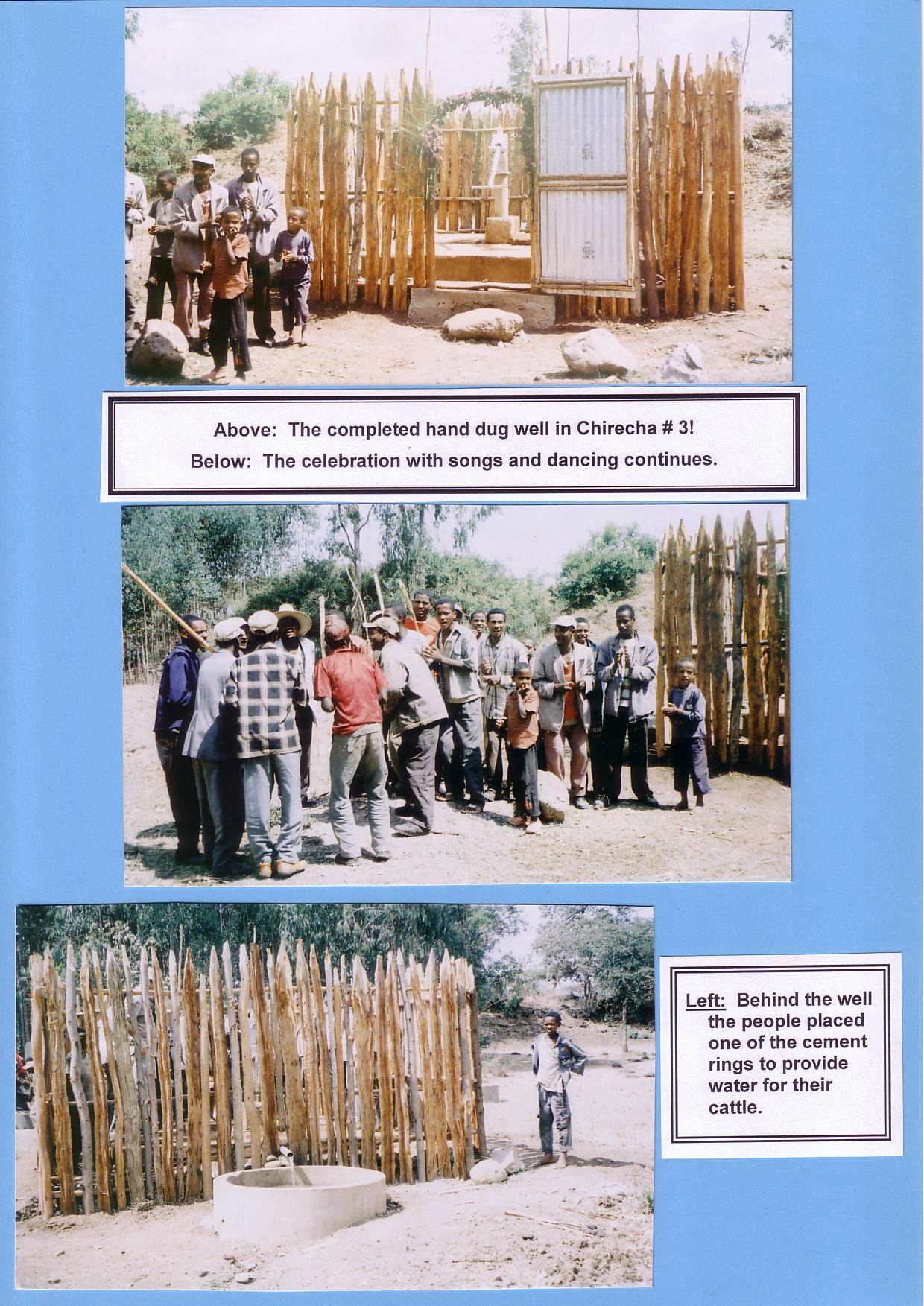
Notes:
Chirecha #3 Hand Dug Well, 10 meters deep, completed in 2010. Serves 360.

Slide 18
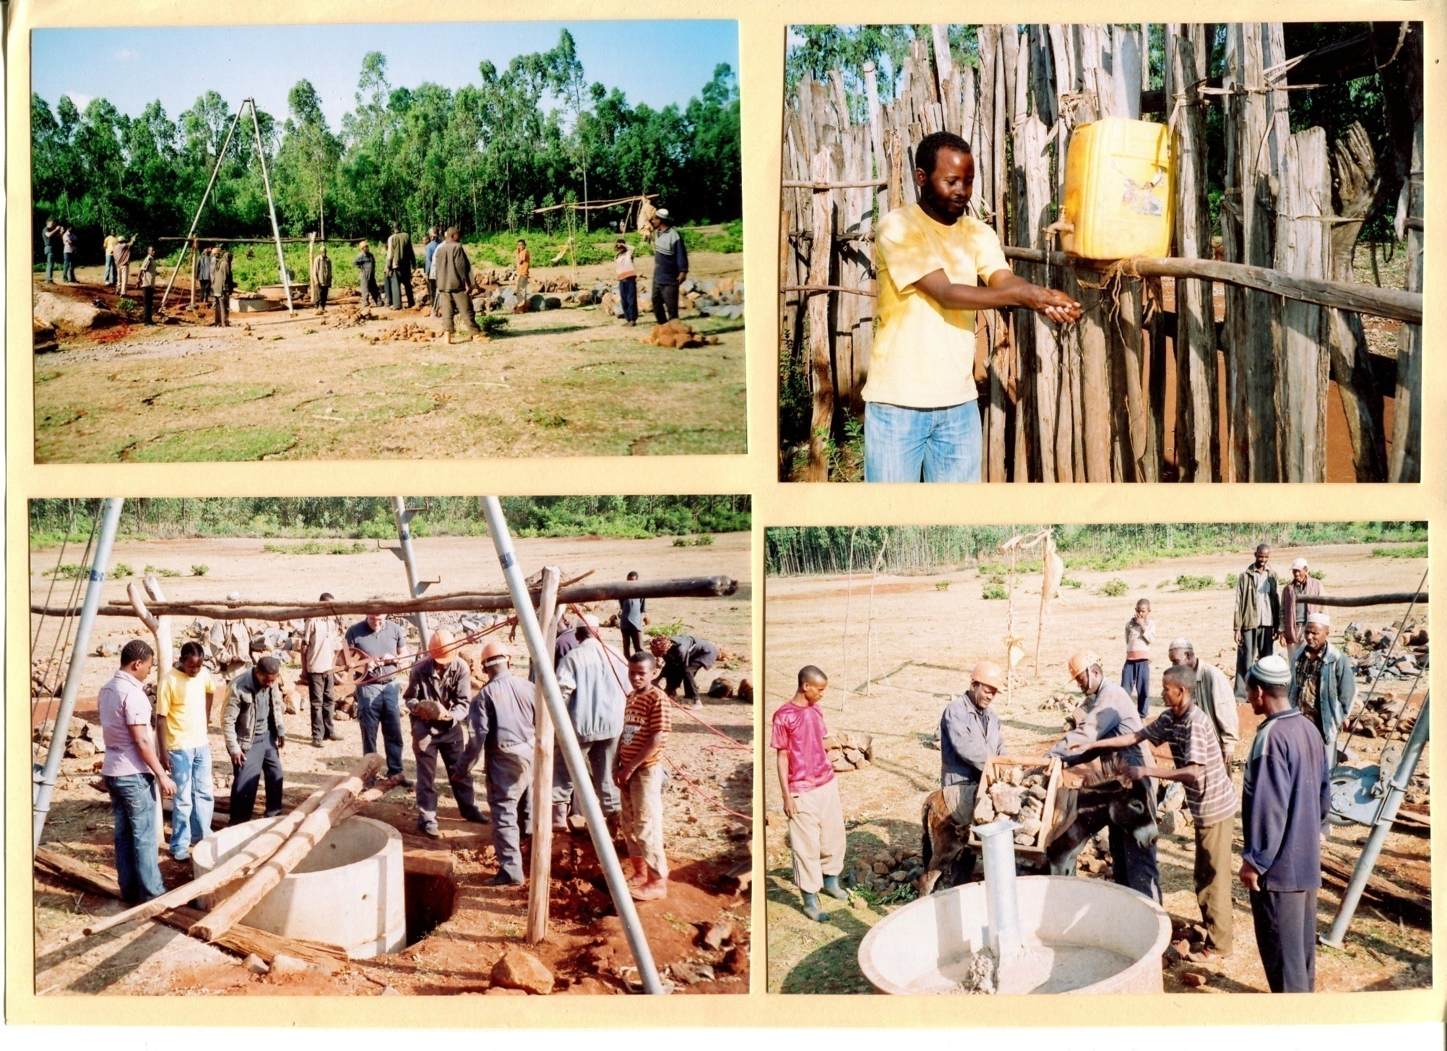
Notes:
Menaco hand dug well, 7 meters deep, completed in 2007 and serves 1,200.

Slide 19
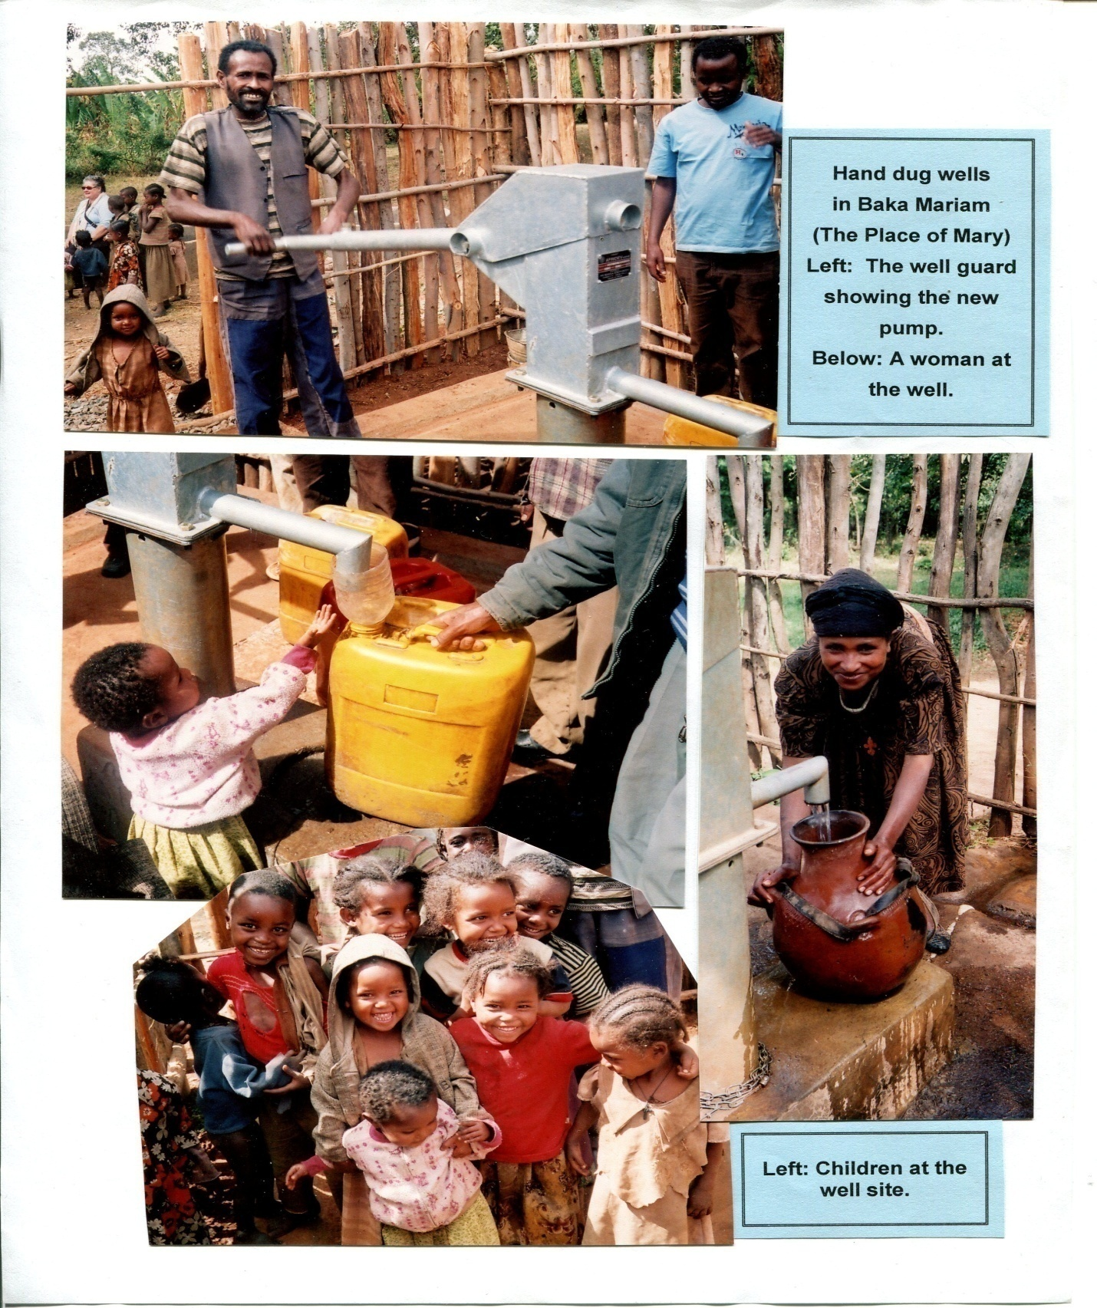
Notes:
Baka Mariam hand dug well, 4.5 meters, serves 1,000, completed in 2007.

Slide 20
THANK YOU !

