Slide 1
A three-pronged,
community-based approach
to tackle gender-based violence in underprivileged locations
of South Africa
CATHOLIC HEALTH CARE
ASSOCIATION OF SOUTHERN AFRICA

Slide 2
Project Partners
The Catholic Health Care Association (CATHCA) is the implementing partner in collaboration with 5 community-based organizations (25 community advocates) from impoverished areas, linked to religious congregations.
CATHCA is a membership organization of roughly 200 Catholic health providers (Catholic Health Network) serving the poor and marginalized in South Africa, Botswana and Eswatini.
It was founded in 1987 by the Southern African Catholic Bishops Conference (SACBC) and the Leadership Conference of Consecrated Life (LCCL-SA)
Misean Cara is the main funder of the project through the Missionary Sisters of the Assumption who provide project oversight.

Slide 3
Key observations about gender-based violence in the target communities
Patriarchal belief system and toxic masculinities that lead to the normalization and acceptance of violence in social relationships, coupled with disempowerment/dependence of women.
Lack of knowledge of the instruments available to prevent/respond to GBVF, and negative attitudes that increase women's vulnerability to GBVF.
Challenges experienced by GBV victims and women at risk of abuse in accessing support services that meet their needs for safety, health, justice, and empowerment.
Slow or lack of adequate response from duty bearers such as the SAPS, DSD and DOH—and sometimes secondary victimisation.
The lack of consequence regarding human rights violations.

Slide 4
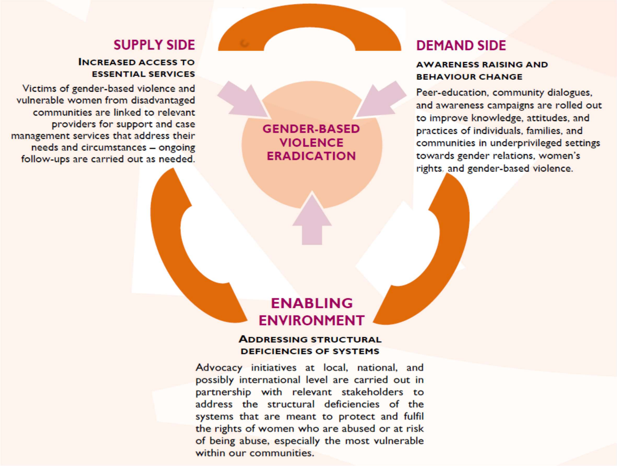
Theory of Change

Slide 5
Key learnings and recommendations
South Africa has developed a progressive policy framework to address GBVF but its effective implementation is hampered by huge challenges, especially in underprivileged communities.
Community advocates (peer educators/role models) are the cornerstone of the fight against GBVF in underprivileged communities but require ongoing support, mentoring and supportive supervision in a spirit of accompaniment.
Awareness raising and behavior-change education against GBVF have to be complemented by person-centred referrals (and follow-ups) of victims to support services that meet their needs and reduce their vulnerabilities.
A partnership mentality must be adopted by duty bearers, civil society and community groups to uphold women’s rights in disadvantaged communities and to ensure that perpetrators are held accountable.

Slide 6
Thank you……

