Slide 1
Global community hour
May 2022

Slide 2
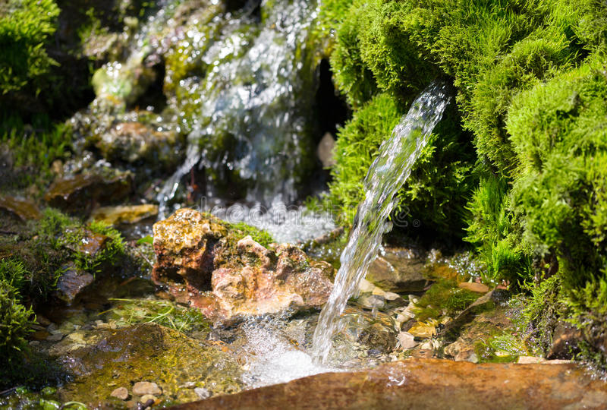
from Dwellings by Linda Hogan, Chickasaw poet & novelist
Notes:
“Water seeps out of the rock canyon above me. It has been around the world. It has lived beneath the lights of fireflies in bayous at night when mist laid itself about cypress trunks. It has held sea turtles in its rocking arms. It has been the Nile River, which at this moment is the smallest it has been in all recorded history. It has come from the rainforest that gave birth to our air. It brings with it stories of where it’s been. It reminds us that we are water people. Our salt bodies, like the great round of ocean, are pulled and held by the moon. We are creatures that belong here. This world is in our blood and bones, and our blood and bones are the earth.
Out from bare rock the water flows, from times before our time. The clouds flying overhead are rivers. Thunder breaks open, and those rivers fall like a sprinkling of baptismal water, giving itself back, everything a round river, in a circle, alive and moving.”

Slide 3
“Perhaps we cannot know the river. But what about the drops? …I close my eyes and listen to the voices of rain. The reflecting surface of the pool is textured with their signatures, each one different in pace and resonance. We think of it simply as rain, as if it were one thing as if we understood it…Maybe there is no such thing as rain; there are only raindrops, each with its own story. - Robin Wall Kimmerer, Potowatomi scientist & writer
Notes:
We pray today in celebration of the “round river,” the circle of life we can trace in the path of water.
As we celebrate, we notice, in the words of Potowatomi scientist and writer Robin Wall Kimmerer…
Let us pray then, by giving our attention to some of the drops in our river..to remember the blessings that have rained upon us.

Slide 4
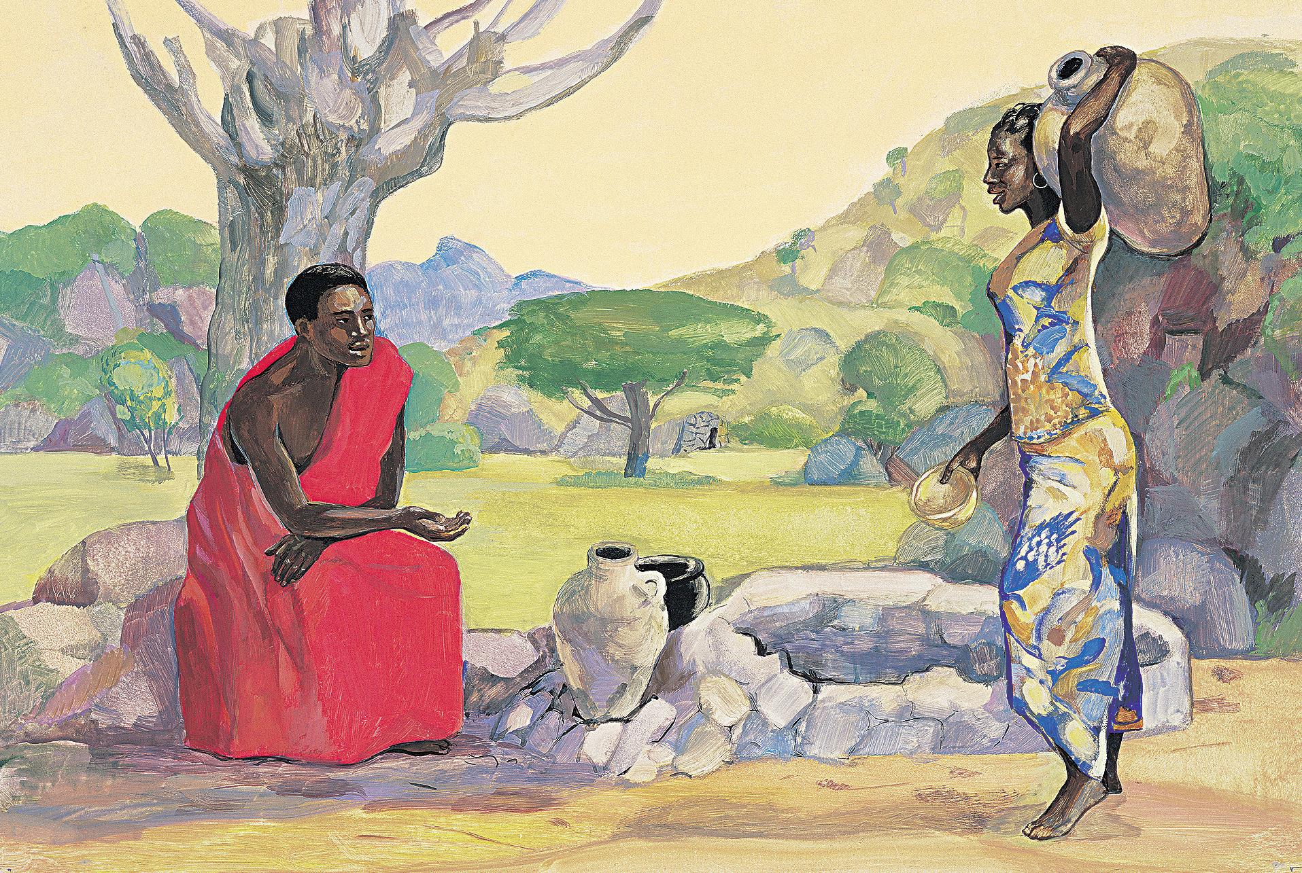
Let us pause for a moment of silence in gratitude for a specific time and place, a specific moment, in which we encountered water as a blessing.

Slide 5
“Grief is a powerful solvent, capable of softening the hardest of places in our hearts. When we can truly weep, [for others, for ourselves, for the places in ourselves and our world that are bearing sorrow and shame], we have invited the first soothing waters of healing to wash through our souls. Grieving, by its very nature, confirms worth. [This is] worth crying over; [this loss] matters.” Francis Weller
Notes:
In our celebration of drops in the ocean of life, let us remember also OUR capacity to be like clouds that rain blessings on the world. With every tear we shed for the sorrows of the world, for the sorrows of one another, we continue this cycle. We participate in the flowing of this round river of living water that connects us all, not only physically, but spiritually.
As Francis Weller reminds us…

Slide 6
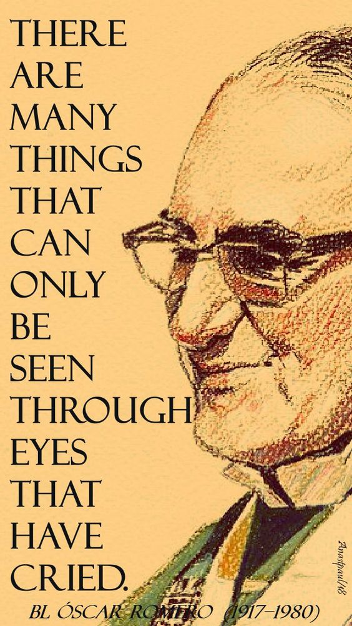
Notes:
We recall the wisdom of grief, of which Oscar Romero reminded us when he said…

Slide 7
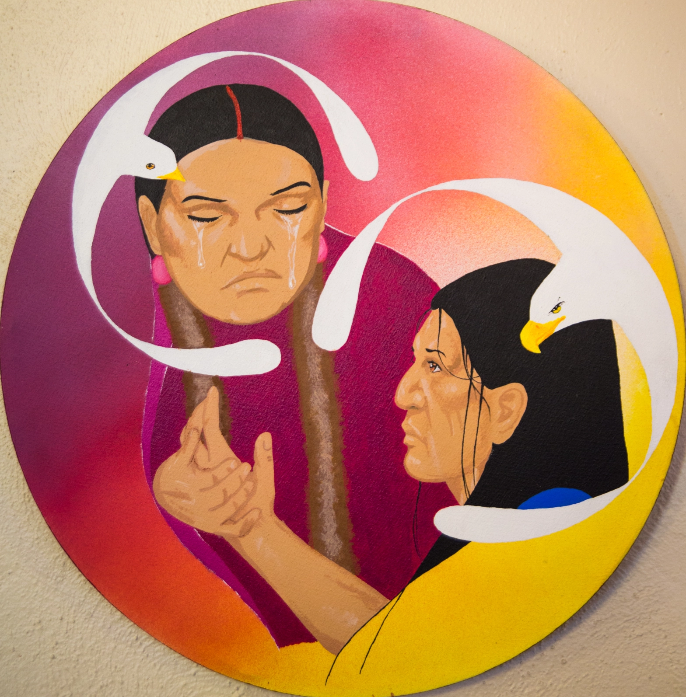
Let us pause for a moment of silence in honor of a specific individual or group for whom we have wept, which is to say, in honor of someone whom we have blessed with our tears).

Slide 8
Blessing for Water by Starhawk
Alabanza y gratitud a las aguas sagradas del mundo, a los océanos, la madre de la vida, el vientre de la vida vegetal que refresca nuestro aire con oxígeno, el brebaje que es agitado por la luz del sol y la gravedad de la luna en las grandes corrientes y mareas que se mueven a través de la tierra, haciendo circular los medios de vida, trayendo calor al ártico congelado y vientos frescos y frescos a los trópicos.
TODAS y TODOS: BENDITA SEA EL AGUA.
Praise and gratitude to the sacred waters of the world, to the oceans, the mother of life, the womb of the plant life that freshens our air with oxygen, the brew that is stirred by sunlight and the moon's gravity into the great currents and tides that move across the earth, circulating the means of life, bringing warmth to the frozen arctic and cool, fresh winds to the tropics.
All: Blessed be the water.

Slide 9
We give thanks for the blessed clouds and the rain that brings the gift of life to the land, that eases the thirst of roots, that grows the trees and sustains life even in the dry desert. We give thanks for the springs that bring life-giving water up from the ground, for the small streams and creeks, for the mighty rivers.
All: Blessed be the water.
Damos gracias por las benditas nubes y la lluvia que trae el don de la vida a la tierra, que alivia la sed de las raíces, que hace crecer los árboles y sostiene la vida incluso en el desierto seco. Damos gracias por los manantiales que hacen surgir del suelo el agua que da vida, por los pequeños arroyos y riachuelos, por los caudalosos ríos
TODAS y TODOS: BENDITA SEA EL AGUA.

Slide 10
We praise the beauty of water, the sparkle of the sunlight on a blue lake, the shimmer of moonlight on the ocean's waves, the white spray of the waterfall. We take delight in the sweet singing of the dancing stream and the roar of the river in the flood.
All: Blessed be the water.
Alabamos la belleza del agua, el brillo de la luz del sol en un lago azul, el resplandor de la luz de la luna en las olas del océano, el blanco rocío de la cascada. Nos deleitamos con el dulce canto del arroyo danzante y el rugido del río en la crecida.
TODAS y TODOS: BENDITA SEA EL AGUA.

Slide 11
We ask help to know within ourselves all the powers of water: to wear down and to build up, to ebb and to flow, to nurture and to destroy, to merge and to separate. We know that water has great powers of healing and cleansing, and we also know that water is vulnerable to contamination and pollution.
All: Blessed be the water.
Pedimos ayuda para conocer en nuestro interior todos los poderes del agua: desgastar y construir, refluir y fluir, nutrir y destruir, fusionar y separar. Sabemos que el agua tiene grandes poderes de curación y limpieza, y también sabemos que el agua es vulnerable a la contaminación y la polución.
TODAS y TODOS: BENDITA SEA EL AGUA.

Slide 12
We ask help in our work as healers, in our efforts to ensure that the waters of the world run clean and run free, that all the earth's children have the water they need to sustain abundance of life.
All: Blessed be the water.
Pedimos ayuda en nuestro trabajo como sanadores, en nuestros esfuerzos por garantizar que las aguas del mundo corran limpias y libres, que todos los hijos de la tierra tengan el agua que necesitan para mantener la abundancia de vida.
TODAS y TODOS: BENDITA SEA EL AGUA.

